Slide 1

WSQ | DIGITAL IMAGE PRODUCTION
Mastering Adobe Lightroom for Photo Editing
From capture to delivery: make every pixel intentional, traceable, and fit for purpose.
Course Code: TGS-2022015367
Trainer: Dr. Alfred Ang
Version v12.0 | 19 August 2026
Tertiary Infotech Academy Pte Ltd | UEN 201200696W
Mastering Adobe Lightroom for Photo Editing | TGS-2022015367 | © Tertiary Infotech Academy Pte Ltd
1

Slide 2
SECTION 00
Course Administration
Welcome | expectations | assessment | resources
Observe the image. State the intent. Make a controlled change. Verify the result.
Mastering Adobe Lightroom for Photo Editing | TGS-2022015367 | © Tertiary Infotech Academy Pte Ltd
2

Slide 3
MANDATORY DIGITAL ATTENDANCE
Digital Attendance | TRAQOM · SSG
1
AM
2
PM
Scan and submit the morning attendance QR code.
Scan and submit the afternoon attendance QR code.
3
ASSESSMENT
4
75% MINIMUM
Complete the separate assessment digital attendance.
Attendance and competent assessment outcome are funding requirements.
Mastering Adobe Lightroom for Photo Editing | TGS-2022015367 | © Tertiary Infotech Academy Pte Ltd
3

Slide 4
YOUR FACILITATOR
About the Trainer
NAME
________________________________
?
TITLE / DESIGNATION
________________________________
QUALIFICATIONS
________________________________
General Trainer
AREAS OF EXPERTISE
________________________________
Trainer profile template
TRAINING EXPERIENCE
________________________________
CONTACT
________________________________
Mastering Adobe Lightroom for Photo Editing | TGS-2022015367 | © Tertiary Infotech Academy Pte Ltd
4

Slide 5
YOUR FACILITATOR
About the Trainer
ROLE
Principal Trainer and learning architect
AA
SPECIALISM
Digital imaging, creative technology, AI and workflow design
APPROACH
Evidence-led, highly visual and production focused
Dr. Alfred Ang
FACILITATION
Demonstration, deliberate practice and stakeholder critique
Principal Trainer | Tertiary Infotech Academy
ORGANISATION
Tertiary Infotech Academy Pte Ltd
CONTACT
enquiry@tertiaryinfotech.com
Mastering Adobe Lightroom for Photo Editing | TGS-2022015367 | © Tertiary Infotech Academy Pte Ltd
5

Slide 6
LEARNER INTRODUCTION
Let’s Know Each Other
1
Your name and role
2
The photographs you edit or want to edit
3
Your current Lightroom experience
4
One quality or workflow problem you want to solve
Mastering Adobe Lightroom for Photo Editing | TGS-2022015367 | © Tertiary Infotech Academy Pte Ltd
6

Slide 7
HOW WE WILL WORK
Ground Rules
1
PROTECT ORIGINALS
2
EDIT WITH INTENT
Work non-destructively and keep source files intact.
State the visual problem before moving a control.
3
CHECK AT 100%
4
RESPECT RIGHTS
Inspect edges, texture, artefacts, and masks.
Use only approved images and protect personal metadata.
Mastering Adobe Lightroom for Photo Editing | TGS-2022015367 | © Tertiary Infotech Academy Pte Ltd
7

Slide 8
COURSE OUTLINE | 9:00 AM-6:00 PM
One-Day Learning Journey
1
2
3
4
5
Brief and ingest
Organise and experiment
Evaluate and refine
Review and deliver
OQ then PP
Mastering Adobe Lightroom for Photo Editing | TGS-2022015367 | © Tertiary Infotech Academy Pte Ltd
8

Slide 9
WHAT YOU WILL BE ABLE TO DO
Learning Outcomes
1
LO1
2
LO2
Explore ideas and techniques of digital imagery with stakeholders and improve production techniques through practice and experimentation.
Evaluate digital-imaging capabilities against theoretical contexts and principles of design.
3
LO3
4
PRODUCTION LENS
Discuss and document the digital-image production process with others while applying intellectual-property considerations.
Connect every edit to a brief, evidence, rights status, and output requirement.
Mastering Adobe Lightroom for Photo Editing | TGS-2022015367 | © Tertiary Infotech Academy Pte Ltd
9

Slide 10
WSQ COMPETENCY MAP
Skills Framework Alignment
TSC
KNOWLEDGE
ABILITIES
Digital Image Production
RET-DNI-4003-1.1
K1-K6: techniques, tools, workspace, theory, design and IP
A1-A4: consult, improve, evaluate and discuss production
Mastering Adobe Lightroom for Photo Editing | TGS-2022015367 | © Tertiary Infotech Academy Pte Ltd
10

Slide 11
6.5 TRAINING HOURS + 1.5 ASSESSMENT HOURS
Lesson Plan
1
2
3
4
5
9:00 | foundations
10:30 | organise
11:15 | edit
15:05 | advanced + delivery
16:30 | OQ + PP
Mastering Adobe Lightroom for Photo Editing | TGS-2022015367 | © Tertiary Infotech Academy Pte Ltd
11

Slide 12
ASSESSMENT READINESS
Briefing for Assessment
1
Individual, summative, open book; no discussion
2
Use only approved course materials; phones and other materials under the table
3
Oral Questioning: 30 minutes; Practical Performance: 60 minutes
4
Submit required evidence on the LMS and sign the Assessment Summary Record
Mastering Adobe Lightroom for Photo Editing | TGS-2022015367 | © Tertiary Infotech Academy Pte Ltd
12

Slide 13
OPEN BOOK | INDIVIDUAL
Assessment and Funding
OQ | 30 MIN
PP | 60 MIN
COMPETENCE
Six open-ended questions covering K1-K6.
Three connected production tasks covering A1-A4.
All required criteria competent; reassessment and appeal rights apply.
Mastering Adobe Lightroom for Photo Editing | TGS-2022015367 | © Tertiary Infotech Academy Pte Ltd
13

Slide 14
ASSESSMENT PROCESS
Assessment Flow
1
2
3
4
5
TRAQOM
Assessment attendance
OQ then PP
Submit on LMS
Sign summary record
Mastering Adobe Lightroom for Photo Editing | TGS-2022015367 | © Tertiary Infotech Academy Pte Ltd
14

Slide 15

COURSE PORTAL
Login to LMS and Download Course Material
Log in at lms-tms.tertiaryinfotech.com with your registered email and the OTP sent to your inbox, then open this course to download the slides and Learner Guide.
Mastering Adobe Lightroom for Photo Editing | TGS-2022015367 | © Tertiary Infotech Academy Pte Ltd
15

Slide 16
LEARNER RESOURCES
Access the Course Activities
Every activity has its own folder with source images, a realistic production scenario, detailed workflow, worksheet, and acceptance checklist in Markdown and PDF.
OPTION A | CLONE
OPTION B | DOWNLOAD
git clone https://github.com/tertiarycourses/TGS-2022015367-Mastering-Adobe-Lightroom-for-Photo-Editing.git
Open GitHub > Code > Download ZIP
https://github.com/tertiarycourses/TGS-2022015367-Mastering-Adobe-Lightroom-for-Photo-Editing
Mastering Adobe Lightroom for Photo Editing | TGS-2022015367 | © Tertiary Infotech Academy Pte Ltd
16

Slide 17
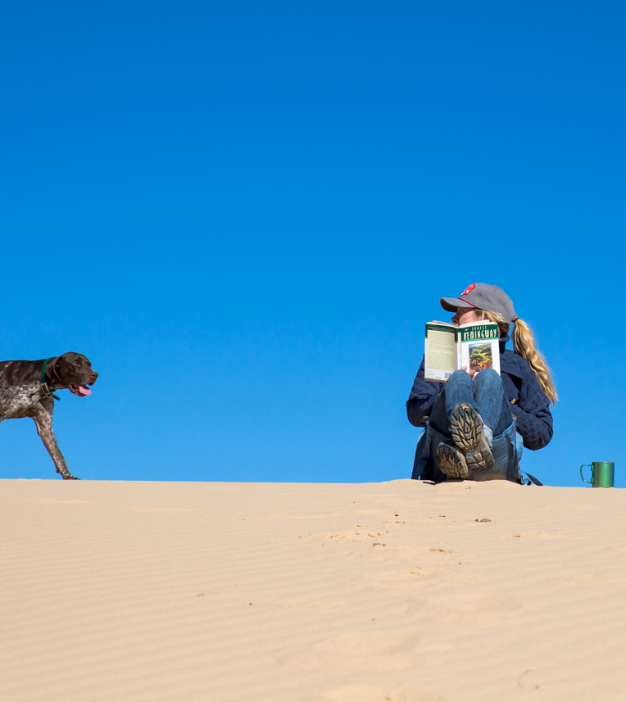
SECTION 01
Get Started on Digital Imagery Techniques Using Lightroom
ecosystem | workspace | brief | ingest | cull | organise | experiment | K1, K2, K3, A1, A2
Observe the image. State the intent. Make a controlled change. Verify the result.
Mastering Adobe Lightroom for Photo Editing | TGS-2022015367 | © Tertiary Infotech Academy Pte Ltd
17

Slide 18
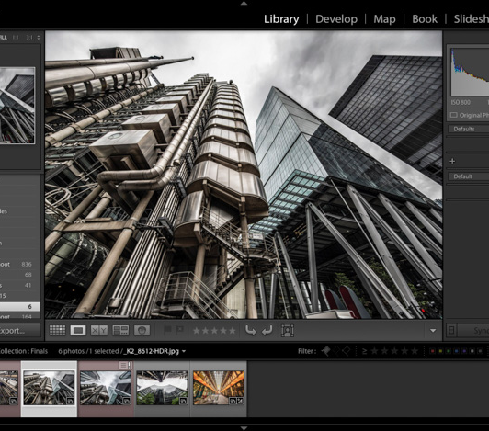
THE EDITING ADVANTAGE
Lightroom Is a Non-Destructive Production System
Treat every edit as a reversible decision, not a one-way alteration.
Original pixels remain intact
Edits are stored as instructions
Versions support safe experimentation
Exports create delivery copies
Mastering Adobe Lightroom for Photo Editing | TGS-2022015367 | © Tertiary Infotech Academy Pte Ltd
18

Slide 19
FROM PRINCIPLE TO PRACTICE
Lightroom Is a Non-Destructive Production System | What mastery looks like
1
Original pixels remain intact
2
Edits are stored as instructions
Connect the control or decision to the brief, inspect the evidence, and compare the result.
Connect the control or decision to the brief, inspect the evidence, and compare the result.
3
Versions support safe experimentation
4
Exports create delivery copies
Connect the control or decision to the brief, inspect the evidence, and compare the result.
Connect the control or decision to the brief, inspect the evidence, and compare the result.
Mastering Adobe Lightroom for Photo Editing | TGS-2022015367 | © Tertiary Infotech Academy Pte Ltd
19

Slide 20
CASE LENS
Lightroom Is a Non-Destructive Production System | Quality lens
SIGNAL
RISK
BETTER MOVE
Watch for editing the only copy.
An unexamined edit can create artefacts, inconsistency, rights risk, or a delivery failure.
Preserve the original, compare versions, and export derivatives.
Mastering Adobe Lightroom for Photo Editing | TGS-2022015367 | © Tertiary Infotech Academy Pte Ltd
20

Slide 21

THE EDITING ADVANTAGE
Choose the Right Lightroom
The right tool is the one whose storage and collaboration model matches the job.
Lightroom: cloud-first consistency
Lightroom Classic: local catalog control
Web and mobile: review and capture
Photoshop: pixel-level compositing
Mastering Adobe Lightroom for Photo Editing | TGS-2022015367 | © Tertiary Infotech Academy Pte Ltd
21

Slide 22
FROM PRINCIPLE TO PRACTICE
Choose the Right Lightroom | What mastery looks like
1
Lightroom: cloud-first consistency
2
Lightroom Classic: local catalog control
Connect the control or decision to the brief, inspect the evidence, and compare the result.
Connect the control or decision to the brief, inspect the evidence, and compare the result.
3
Web and mobile: review and capture
4
Photoshop: pixel-level compositing
Connect the control or decision to the brief, inspect the evidence, and compare the result.
Connect the control or decision to the brief, inspect the evidence, and compare the result.
Mastering Adobe Lightroom for Photo Editing | TGS-2022015367 | © Tertiary Infotech Academy Pte Ltd
22

Slide 23
PRACTICE LENS | CONCEPTUAL REHEARSAL
Choose the Right Lightroom | Decision loop
1
2
3
4
5
Observe
State intent
Adjust
Compare
Verify
Mastering Adobe Lightroom for Photo Editing | TGS-2022015367 | © Tertiary Infotech Academy Pte Ltd
23

Slide 24
THE EDITING ADVANTAGE
Build a Colour-Aware Workspace
A trustworthy edit begins with a trustworthy viewing environment.
Calibrated display and neutral light
Fast storage with reliable backup
Enough memory and GPU headroom
Consistent viewing conditions
Mastering Adobe Lightroom for Photo Editing | TGS-2022015367 | © Tertiary Infotech Academy Pte Ltd
24

Slide 25
FROM PRINCIPLE TO PRACTICE
Build a Colour-Aware Workspace | What mastery looks like
1
Calibrated display and neutral light
2
Fast storage with reliable backup
Connect the control or decision to the brief, inspect the evidence, and compare the result.
Connect the control or decision to the brief, inspect the evidence, and compare the result.
3
Enough memory and GPU headroom
4
Consistent viewing conditions
Connect the control or decision to the brief, inspect the evidence, and compare the result.
Connect the control or decision to the brief, inspect the evidence, and compare the result.
Mastering Adobe Lightroom for Photo Editing | TGS-2022015367 | © Tertiary Infotech Academy Pte Ltd
25

Slide 26
CASE LENS
Build a Colour-Aware Workspace | Quality lens
SIGNAL
RISK
BETTER MOVE
Watch for editing under coloured light.
An unexamined edit can create artefacts, inconsistency, rights risk, or a delivery failure.
Control the room, display, storage, and backup before judging colour.
Mastering Adobe Lightroom for Photo Editing | TGS-2022015367 | © Tertiary Infotech Academy Pte Ltd
26

Slide 27

THE EDITING ADVANTAGE
Start with a Stakeholder Creative Brief
A beautiful image can still fail if it solves the wrong brief.
Audience and use
Required mood and message
Non-negotiable brand constraints
Approval criteria and deadline
Mastering Adobe Lightroom for Photo Editing | TGS-2022015367 | © Tertiary Infotech Academy Pte Ltd
27

Slide 28
FROM PRINCIPLE TO PRACTICE
Start with a Stakeholder Creative Brief | What mastery looks like
1
Audience and use
2
Required mood and message
Connect the control or decision to the brief, inspect the evidence, and compare the result.
Connect the control or decision to the brief, inspect the evidence, and compare the result.
3
Non-negotiable brand constraints
4
Approval criteria and deadline
Connect the control or decision to the brief, inspect the evidence, and compare the result.
Connect the control or decision to the brief, inspect the evidence, and compare the result.
Mastering Adobe Lightroom for Photo Editing | TGS-2022015367 | © Tertiary Infotech Academy Pte Ltd
28

Slide 29
PRACTICE LENS | CONCEPTUAL REHEARSAL
Start with a Stakeholder Creative Brief | Decision loop
1
2
3
4
5
Observe
State intent
Adjust
Compare
Verify
Mastering Adobe Lightroom for Photo Editing | TGS-2022015367 | © Tertiary Infotech Academy Pte Ltd
29

Slide 30

THE EDITING ADVANTAGE
Image Materials and File Decisions
File format is a production choice: latitude, compatibility, size, and provenance trade places.
RAW retains editing latitude
JPEG is compact and processed
HEIF/WebP balance size and quality
DNG can support archival workflows
Mastering Adobe Lightroom for Photo Editing | TGS-2022015367 | © Tertiary Infotech Academy Pte Ltd
30

Slide 31
FROM PRINCIPLE TO PRACTICE
Image Materials and File Decisions | What mastery looks like
1
RAW retains editing latitude
2
JPEG is compact and processed
Connect the control or decision to the brief, inspect the evidence, and compare the result.
Connect the control or decision to the brief, inspect the evidence, and compare the result.
3
HEIF/WebP balance size and quality
4
DNG can support archival workflows
Connect the control or decision to the brief, inspect the evidence, and compare the result.
Connect the control or decision to the brief, inspect the evidence, and compare the result.
Mastering Adobe Lightroom for Photo Editing | TGS-2022015367 | © Tertiary Infotech Academy Pte Ltd
31

Slide 32
CASE LENS
Image Materials and File Decisions | Quality lens
SIGNAL
RISK
BETTER MOVE
Watch for assuming every file behaves like RAW.
An unexamined edit can create artefacts, inconsistency, rights risk, or a delivery failure.
Inspect capture format and destination before choosing the workflow.
Mastering Adobe Lightroom for Photo Editing | TGS-2022015367 | © Tertiary Infotech Academy Pte Ltd
32

Slide 33
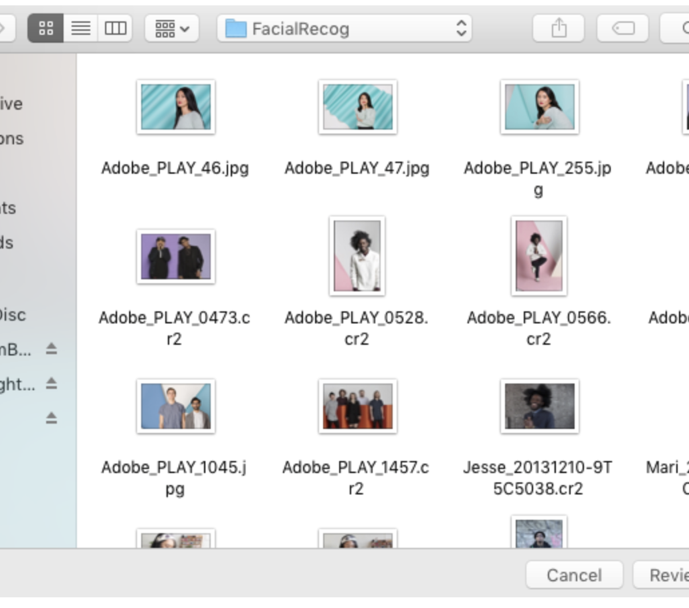
THE EDITING ADVANTAGE
Ingest Without Losing Control
Import is where asset control begins—not an administrative afterthought.
Verify source and destination
Avoid duplicate imports
Name the project and album
Confirm backup and sync state
Mastering Adobe Lightroom for Photo Editing | TGS-2022015367 | © Tertiary Infotech Academy Pte Ltd
33

Slide 34
FROM PRINCIPLE TO PRACTICE
Ingest Without Losing Control | What mastery looks like
1
Verify source and destination
2
Avoid duplicate imports
Connect the control or decision to the brief, inspect the evidence, and compare the result.
Connect the control or decision to the brief, inspect the evidence, and compare the result.
3
Name the project and album
4
Confirm backup and sync state
Connect the control or decision to the brief, inspect the evidence, and compare the result.
Connect the control or decision to the brief, inspect the evidence, and compare the result.
Mastering Adobe Lightroom for Photo Editing | TGS-2022015367 | © Tertiary Infotech Academy Pte Ltd
34

Slide 35
PRACTICE LENS | CONCEPTUAL REHEARSAL
Ingest Without Losing Control | Decision loop
1
2
3
4
5
Observe
State intent
Adjust
Compare
Verify
Mastering Adobe Lightroom for Photo Editing | TGS-2022015367 | © Tertiary Infotech Academy Pte Ltd
35

Slide 36
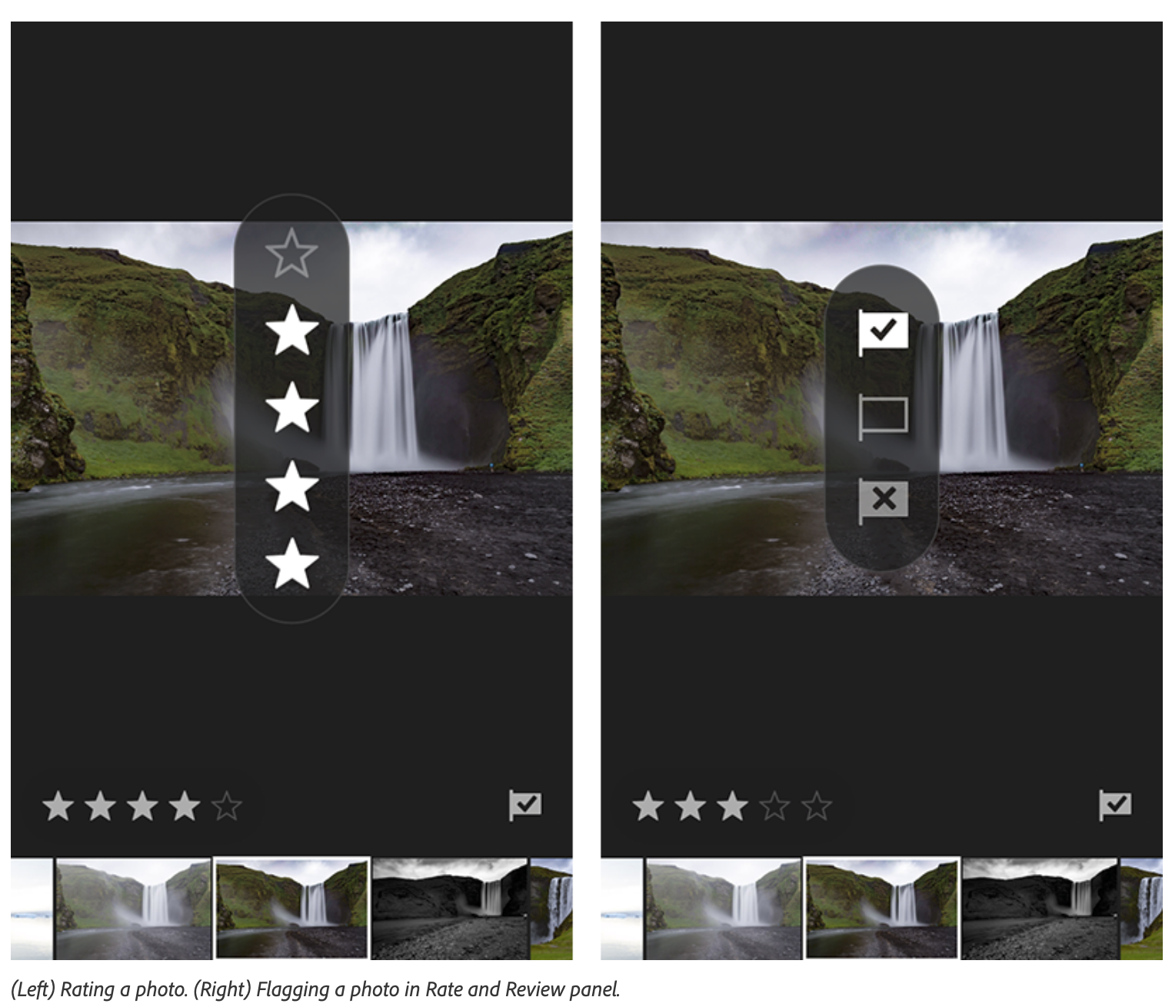
THE EDITING ADVANTAGE
Cull for Story, Quality, and Risk
The strongest edit cannot rescue the wrong frame.
Technical quality
Expression and decisive moment
Visual variety
Rights and stakeholder fit
Mastering Adobe Lightroom for Photo Editing | TGS-2022015367 | © Tertiary Infotech Academy Pte Ltd
36

Slide 37
FROM PRINCIPLE TO PRACTICE
Cull for Story, Quality, and Risk | What mastery looks like
1
Technical quality
2
Expression and decisive moment
Connect the control or decision to the brief, inspect the evidence, and compare the result.
Connect the control or decision to the brief, inspect the evidence, and compare the result.
3
Visual variety
4
Rights and stakeholder fit
Connect the control or decision to the brief, inspect the evidence, and compare the result.
Connect the control or decision to the brief, inspect the evidence, and compare the result.
Mastering Adobe Lightroom for Photo Editing | TGS-2022015367 | © Tertiary Infotech Academy Pte Ltd
37

Slide 38
CASE LENS
Cull for Story, Quality, and Risk | Quality lens
SIGNAL
RISK
BETTER MOVE
Watch for rating only sharpness.
An unexamined edit can create artefacts, inconsistency, rights risk, or a delivery failure.
Select against the brief, narrative value, technical quality, and usage rights.
Mastering Adobe Lightroom for Photo Editing | TGS-2022015367 | © Tertiary Infotech Academy Pte Ltd
38

Slide 39
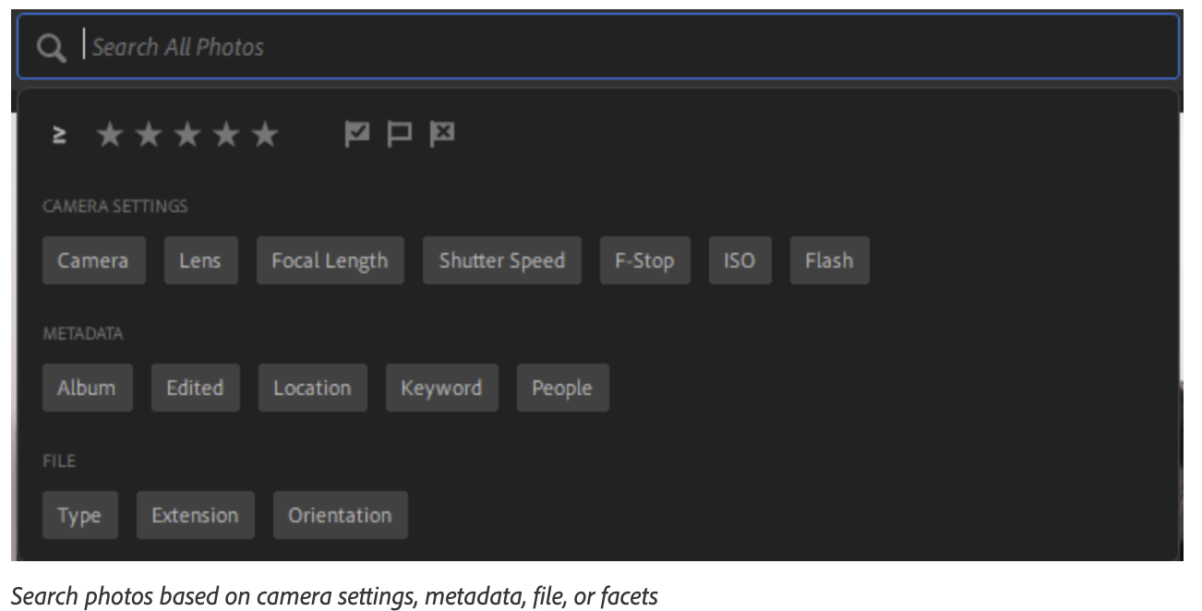
THE EDITING ADVANTAGE
Organise for Retrieval
An image library creates value only when the right asset can be found again.
Albums and folders
Flags, stars, and colour labels
Keywords and metadata
Natural-language and facet search
Mastering Adobe Lightroom for Photo Editing | TGS-2022015367 | © Tertiary Infotech Academy Pte Ltd
39

Slide 40
FROM PRINCIPLE TO PRACTICE
Organise for Retrieval | What mastery looks like
1
Albums and folders
2
Flags, stars, and colour labels
Connect the control or decision to the brief, inspect the evidence, and compare the result.
Connect the control or decision to the brief, inspect the evidence, and compare the result.
3
Keywords and metadata
4
Natural-language and facet search
Connect the control or decision to the brief, inspect the evidence, and compare the result.
Connect the control or decision to the brief, inspect the evidence, and compare the result.
Mastering Adobe Lightroom for Photo Editing | TGS-2022015367 | © Tertiary Infotech Academy Pte Ltd
40

Slide 41
PRACTICE LENS | CONCEPTUAL REHEARSAL
Organise for Retrieval | Decision loop
1
2
3
4
5
Observe
State intent
Adjust
Compare
Verify
Mastering Adobe Lightroom for Photo Editing | TGS-2022015367 | © Tertiary Infotech Academy Pte Ltd
41

Slide 42
THE EDITING ADVANTAGE
Experiment with Versions and Comparisons
Controlled comparison turns taste into a learnable editing method.
Create alternate versions
Change one variable at a time
Use before/after evidence
Record stakeholder decisions
Mastering Adobe Lightroom for Photo Editing | TGS-2022015367 | © Tertiary Infotech Academy Pte Ltd
42

Slide 43
FROM PRINCIPLE TO PRACTICE
Experiment with Versions and Comparisons | What mastery looks like
1
Create alternate versions
2
Change one variable at a time
Connect the control or decision to the brief, inspect the evidence, and compare the result.
Connect the control or decision to the brief, inspect the evidence, and compare the result.
3
Use before/after evidence
4
Record stakeholder decisions
Connect the control or decision to the brief, inspect the evidence, and compare the result.
Connect the control or decision to the brief, inspect the evidence, and compare the result.
Mastering Adobe Lightroom for Photo Editing | TGS-2022015367 | © Tertiary Infotech Academy Pte Ltd
43

Slide 44
CASE LENS
Experiment with Versions and Comparisons | Quality lens
SIGNAL
RISK
BETTER MOVE
Watch for random slider wandering.
An unexamined edit can create artefacts, inconsistency, rights risk, or a delivery failure.
Set a hypothesis, make one purposeful change, compare, and record.
Mastering Adobe Lightroom for Photo Editing | TGS-2022015367 | © Tertiary Infotech Academy Pte Ltd
44

Slide 45
MASTER EDITOR PRINCIPLE
“Treat every edit as a reversible decision, not a one-way alteration.”
Use this as the topic's decision rule, then prove it through the activity evidence.
ORIGINAL COURSE MAXIM
Mastering Adobe Lightroom for Photo Editing | TGS-2022015367 | © Tertiary Infotech Academy Pte Ltd
45

Slide 46
REAL-WORKPLACE PRACTICE
Activity 01 | Stakeholder Brief and Colour-Safe Workspace
K1, K2, K3, A1, A2
BrightFrame Studio has been hired by a Singapore wellness brand to prepare a calm, premium hero photograph for a mobile campaign. The brand manager wants natural skin and product colour; the photographer wants a warmer editorial mood; the campaign lead needs a 4:5 crop by 4 pm. The studio monitor has not been checked recently and mixed office lighting affects colour judgement.
STAKEHOLDER LENS
EVIDENCE
QUALITY GATE
Work with Photo editor, Brand manager, Photographer.
Produce creative-brief translation worksheet and workspace readiness checklist.
Every subjective preference has an observable criterion.
Full click-by-click workflow, scenario, questions, evidence templates, and acceptance criteria are in the Learner Guide and activity PDF pack.
Mastering Adobe Lightroom for Photo Editing | TGS-2022015367 | © Tertiary Infotech Academy Pte Ltd
46

Slide 47
REAL-WORKPLACE PRACTICE
Activity 02 | Marina Bay Event Library: Cull, Organise, and Retrieve
K1, K2, A1, A2
A hospitality group has 16 event photographs from a launch night. Marketing needs six images that show people, venue atmosphere, product detail, and a clean hero frame. The library must support later retrieval by campaign, subject, location, and approval status without duplicating originals.
STAKEHOLDER LENS
EVIDENCE
QUALITY GATE
Work with Digital asset lead, Marketing stakeholder, Event photographer.
Produce six-image final-selects album and culling rationale.
Album count matches the supplied set.
Full click-by-click workflow, scenario, questions, evidence templates, and acceptance criteria are in the Learner Guide and activity PDF pack.
Mastering Adobe Lightroom for Photo Editing | TGS-2022015367 | © Tertiary Infotech Academy Pte Ltd
47

Slide 48
EVIDENCE CHECK
Topic 1 | Evidence of competence
PROOF OF EDITING COMPETENCE
The brief, edit decisions, before/after evidence, quality checks, stakeholder response, rights status, and output specification tell one coherent story.
Mastering Adobe Lightroom for Photo Editing | TGS-2022015367 | © Tertiary Infotech Academy Pte Ltd
48

Slide 49
Lunch Break
45 minutes
Rest your eyes. Return ready to judge detail and colour accurately.
Mastering Adobe Lightroom for Photo Editing | TGS-2022015367 | © Tertiary Infotech Academy Pte Ltd
49

Slide 50
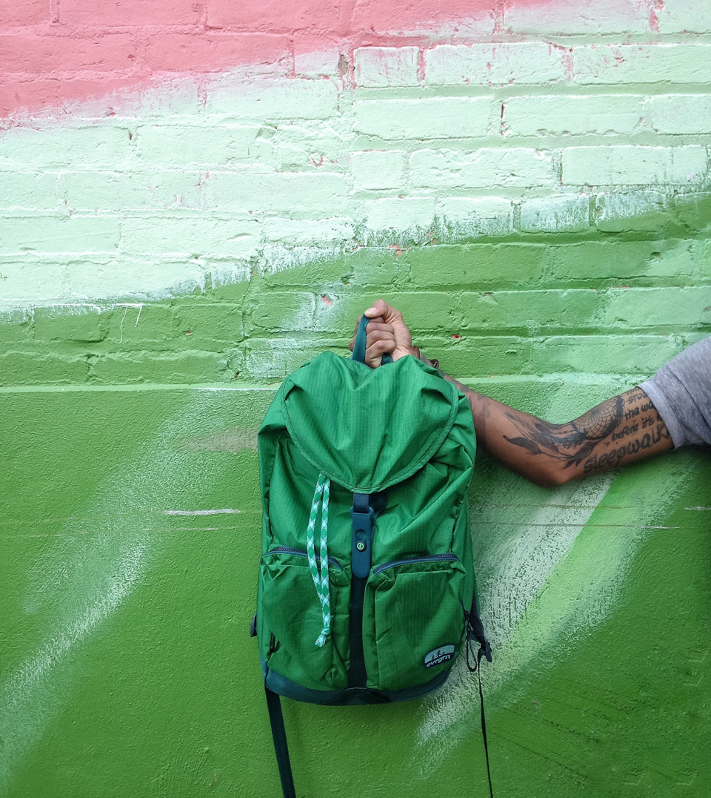
SECTION 02
Evaluate Digital Imaging Capabilities Using Lightroom
design | tone | colour | geometry | detail | masks | AI | workflow order | K4, K5, A3
Observe the image. State the intent. Make a controlled change. Verify the result.
Mastering Adobe Lightroom for Photo Editing | TGS-2022015367 | © Tertiary Infotech Academy Pte Ltd
50

Slide 51
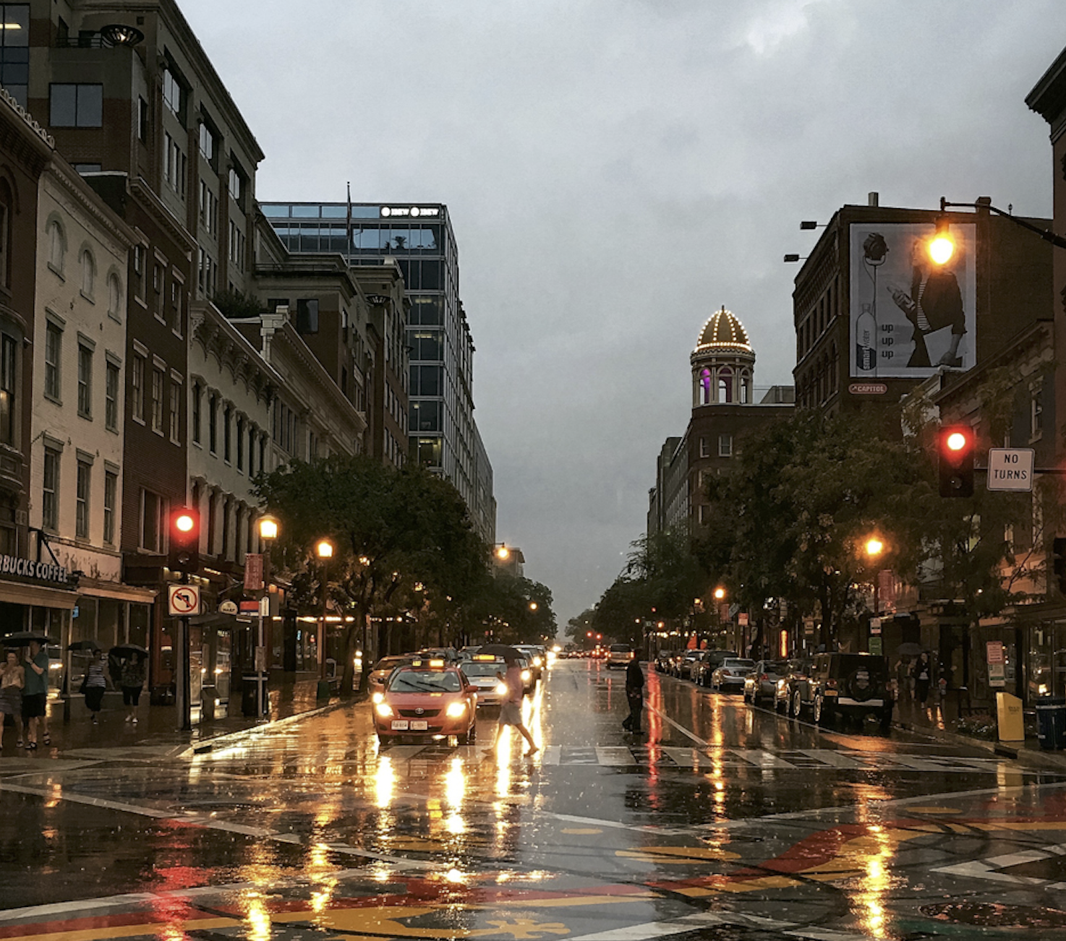
THE EDITING ADVANTAGE
Read the Image Before Editing
Diagnosis should lead the sliders; the sliders should never lead the diagnosis.
Subject and visual hierarchy
Histogram and clipping
Colour cast and skin tone
Distracting edges and geometry
Mastering Adobe Lightroom for Photo Editing | TGS-2022015367 | © Tertiary Infotech Academy Pte Ltd
51

Slide 52
FROM PRINCIPLE TO PRACTICE
Read the Image Before Editing | What mastery looks like
1
Subject and visual hierarchy
2
Histogram and clipping
Connect the control or decision to the brief, inspect the evidence, and compare the result.
Connect the control or decision to the brief, inspect the evidence, and compare the result.
3
Colour cast and skin tone
4
Distracting edges and geometry
Connect the control or decision to the brief, inspect the evidence, and compare the result.
Connect the control or decision to the brief, inspect the evidence, and compare the result.
Mastering Adobe Lightroom for Photo Editing | TGS-2022015367 | © Tertiary Infotech Academy Pte Ltd
52

Slide 53
CASE LENS
Read the Image Before Editing | Quality lens
SIGNAL
RISK
BETTER MOVE
Watch for editing by preset preview.
An unexamined edit can create artefacts, inconsistency, rights risk, or a delivery failure.
State the visual problem, intended response, and evidence of improvement.
Mastering Adobe Lightroom for Photo Editing | TGS-2022015367 | © Tertiary Infotech Academy Pte Ltd
53

Slide 54

THE EDITING ADVANTAGE
Design Principles Guide Every Edit
Editing is design under evidence: every adjustment should strengthen the viewer's path.
Contrast directs attention
Balance stabilises the frame
Colour creates mood and unity
Negative space improves emphasis
Mastering Adobe Lightroom for Photo Editing | TGS-2022015367 | © Tertiary Infotech Academy Pte Ltd
54

Slide 55
FROM PRINCIPLE TO PRACTICE
Design Principles Guide Every Edit | What mastery looks like
1
Contrast directs attention
2
Balance stabilises the frame
Connect the control or decision to the brief, inspect the evidence, and compare the result.
Connect the control or decision to the brief, inspect the evidence, and compare the result.
3
Colour creates mood and unity
4
Negative space improves emphasis
Connect the control or decision to the brief, inspect the evidence, and compare the result.
Connect the control or decision to the brief, inspect the evidence, and compare the result.
Mastering Adobe Lightroom for Photo Editing | TGS-2022015367 | © Tertiary Infotech Academy Pte Ltd
55

Slide 56
PRACTICE LENS | CONCEPTUAL REHEARSAL
Design Principles Guide Every Edit | Decision loop
1
2
3
4
5
Observe
State intent
Adjust
Compare
Verify
Mastering Adobe Lightroom for Photo Editing | TGS-2022015367 | © Tertiary Infotech Academy Pte Ltd
56

Slide 57
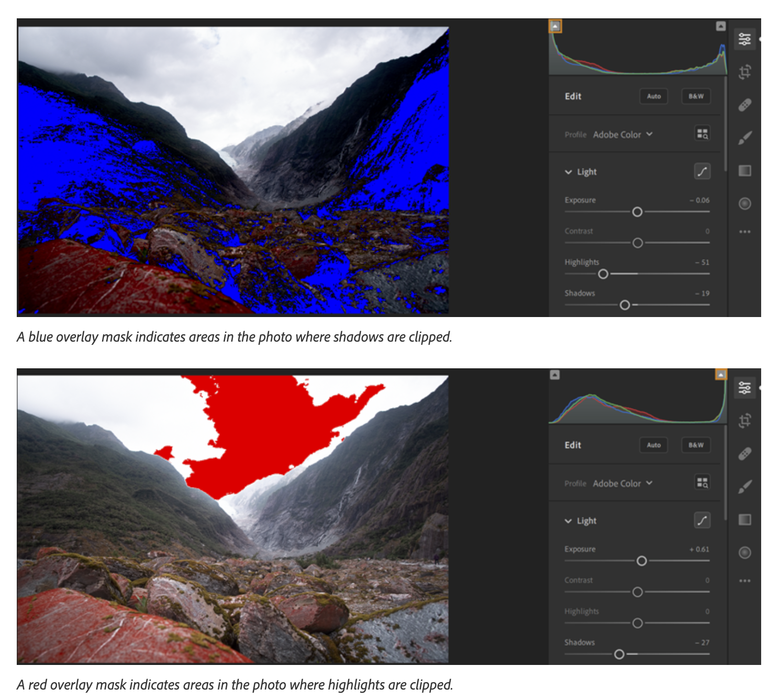
THE EDITING ADVANTAGE
Histogram and Tonal Range
A strong tonal edit protects important detail while preserving intentional contrast.
Exposure moves overall brightness
Highlights and shadows recover zones
Whites and blacks set endpoints
Clipping reveals lost information
Mastering Adobe Lightroom for Photo Editing | TGS-2022015367 | © Tertiary Infotech Academy Pte Ltd
57

Slide 58
FROM PRINCIPLE TO PRACTICE
Histogram and Tonal Range | What mastery looks like
1
Exposure moves overall brightness
2
Highlights and shadows recover zones
Connect the control or decision to the brief, inspect the evidence, and compare the result.
Connect the control or decision to the brief, inspect the evidence, and compare the result.
3
Whites and blacks set endpoints
4
Clipping reveals lost information
Connect the control or decision to the brief, inspect the evidence, and compare the result.
Connect the control or decision to the brief, inspect the evidence, and compare the result.
Mastering Adobe Lightroom for Photo Editing | TGS-2022015367 | © Tertiary Infotech Academy Pte Ltd
58

Slide 59
CASE LENS
Histogram and Tonal Range | Quality lens
SIGNAL
RISK
BETTER MOVE
Watch for flat recovery everywhere.
An unexamined edit can create artefacts, inconsistency, rights risk, or a delivery failure.
Use the histogram as evidence, then judge the subject and mood visually.
Mastering Adobe Lightroom for Photo Editing | TGS-2022015367 | © Tertiary Infotech Academy Pte Ltd
59

Slide 60
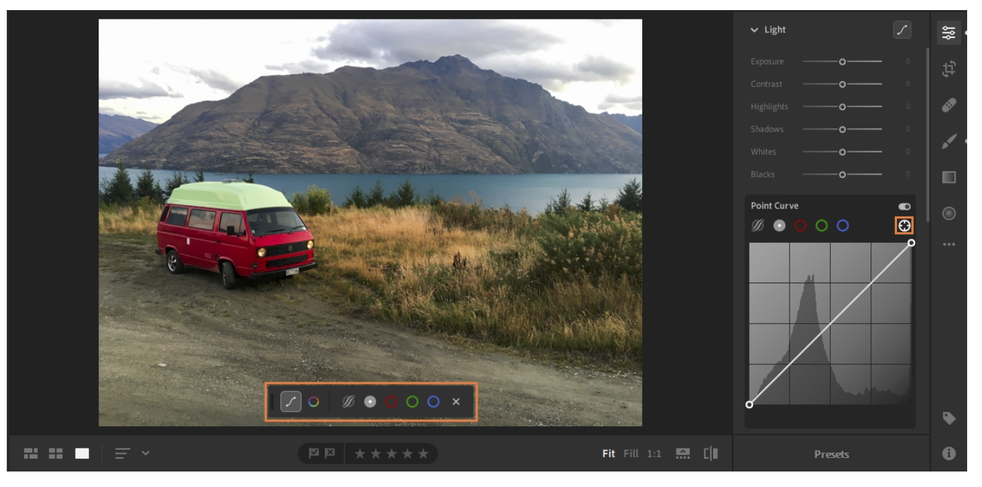
THE EDITING ADVANTAGE
Tone Curve: Shape, Not Decoration
The curve is a map of relationships between input and output tone.
Lift or lower tonal regions
Create controlled contrast
Protect endpoints
Use channel curves for colour balance
Mastering Adobe Lightroom for Photo Editing | TGS-2022015367 | © Tertiary Infotech Academy Pte Ltd
60

Slide 61
FROM PRINCIPLE TO PRACTICE
Tone Curve: Shape, Not Decoration | What mastery looks like
1
Lift or lower tonal regions
2
Create controlled contrast
Connect the control or decision to the brief, inspect the evidence, and compare the result.
Connect the control or decision to the brief, inspect the evidence, and compare the result.
3
Protect endpoints
4
Use channel curves for colour balance
Connect the control or decision to the brief, inspect the evidence, and compare the result.
Connect the control or decision to the brief, inspect the evidence, and compare the result.
Mastering Adobe Lightroom for Photo Editing | TGS-2022015367 | © Tertiary Infotech Academy Pte Ltd
61

Slide 62
PRACTICE LENS | CONCEPTUAL REHEARSAL
Tone Curve: Shape, Not Decoration | Decision loop
1
2
3
4
5
Observe
State intent
Adjust
Compare
Verify
Mastering Adobe Lightroom for Photo Editing | TGS-2022015367 | © Tertiary Infotech Academy Pte Ltd
62

Slide 63
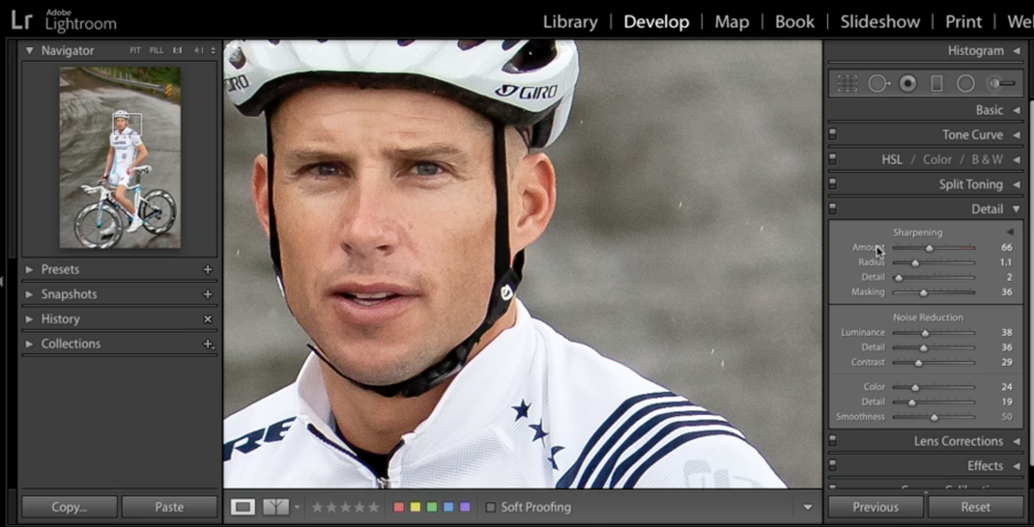
THE EDITING ADVANTAGE
White Balance and Colour Intent
Neutral is not always the goal; believable intention is.
Temperature handles blue-yellow
Tint handles green-magenta
Vibrance protects already-saturated colour
Saturation moves all colours together
Mastering Adobe Lightroom for Photo Editing | TGS-2022015367 | © Tertiary Infotech Academy Pte Ltd
63

Slide 64
FROM PRINCIPLE TO PRACTICE
White Balance and Colour Intent | What mastery looks like
1
Temperature handles blue-yellow
2
Tint handles green-magenta
Connect the control or decision to the brief, inspect the evidence, and compare the result.
Connect the control or decision to the brief, inspect the evidence, and compare the result.
3
Vibrance protects already-saturated colour
4
Saturation moves all colours together
Connect the control or decision to the brief, inspect the evidence, and compare the result.
Connect the control or decision to the brief, inspect the evidence, and compare the result.
Mastering Adobe Lightroom for Photo Editing | TGS-2022015367 | © Tertiary Infotech Academy Pte Ltd
64

Slide 65
CASE LENS
White Balance and Colour Intent | Quality lens
SIGNAL
RISK
BETTER MOVE
Watch for orange skin or radioactive colour.
An unexamined edit can create artefacts, inconsistency, rights risk, or a delivery failure.
Correct casts first, then design the palette with restraint.
Mastering Adobe Lightroom for Photo Editing | TGS-2022015367 | © Tertiary Infotech Academy Pte Ltd
65

Slide 66
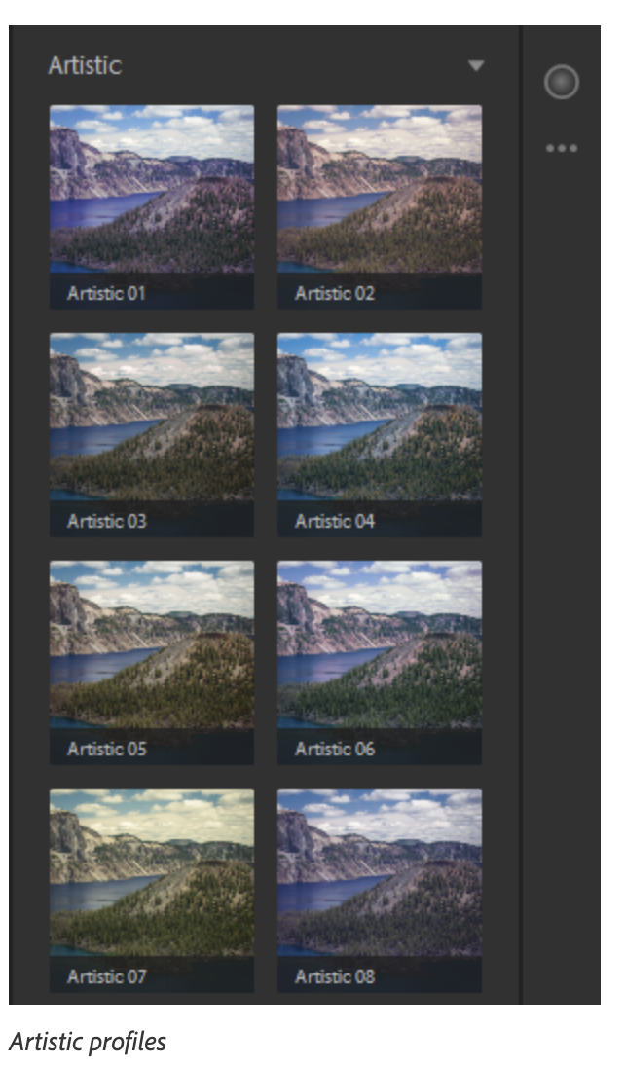
THE EDITING ADVANTAGE
Colour Mixer and Colour Grading
Colour works as a system: local decisions must still belong to one visual world.
Hue changes colour identity
Saturation changes intensity
Luminance changes brightness
Grading separates shadows, midtones, highlights
Mastering Adobe Lightroom for Photo Editing | TGS-2022015367 | © Tertiary Infotech Academy Pte Ltd
66

Slide 67
FROM PRINCIPLE TO PRACTICE
Colour Mixer and Colour Grading | What mastery looks like
1
Hue changes colour identity
2
Saturation changes intensity
Connect the control or decision to the brief, inspect the evidence, and compare the result.
Connect the control or decision to the brief, inspect the evidence, and compare the result.
3
Luminance changes brightness
4
Grading separates shadows, midtones, highlights
Connect the control or decision to the brief, inspect the evidence, and compare the result.
Connect the control or decision to the brief, inspect the evidence, and compare the result.
Mastering Adobe Lightroom for Photo Editing | TGS-2022015367 | © Tertiary Infotech Academy Pte Ltd
67

Slide 68
PRACTICE LENS | CONCEPTUAL REHEARSAL
Colour Mixer and Colour Grading | Decision loop
1
2
3
4
5
Observe
State intent
Adjust
Compare
Verify
Mastering Adobe Lightroom for Photo Editing | TGS-2022015367 | © Tertiary Infotech Academy Pte Ltd
68

Slide 69
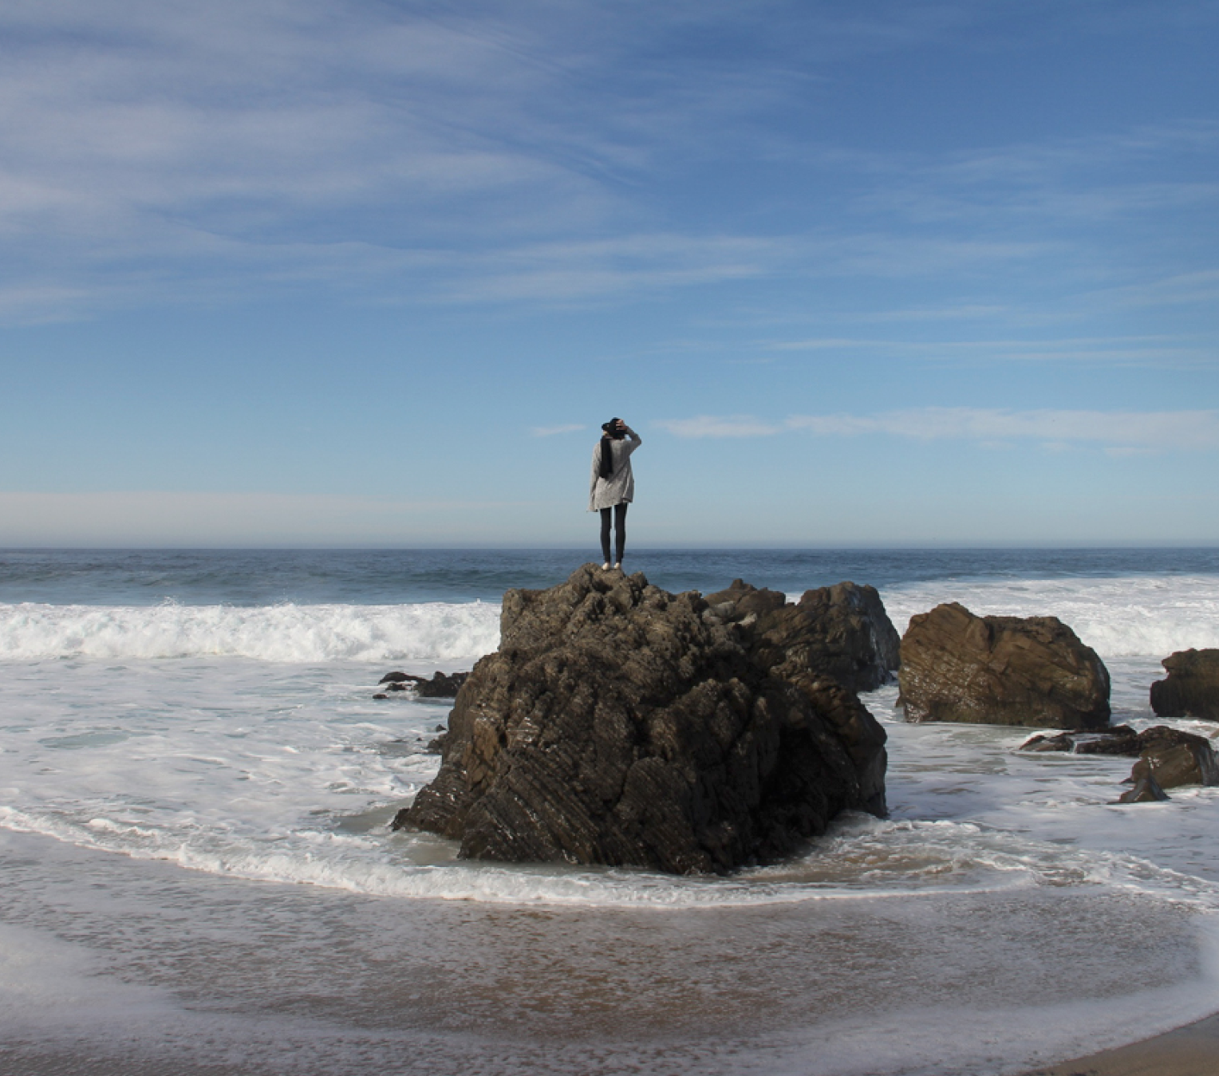
THE EDITING ADVANTAGE
Crop, Straighten, and Geometry
Composition is the first local adjustment: it decides what the image is about.
Aspect ratio follows destination
Crop strengthens hierarchy
Upright corrects perspective
Constrain crop manages empty edges
Mastering Adobe Lightroom for Photo Editing | TGS-2022015367 | © Tertiary Infotech Academy Pte Ltd
69

Slide 70
FROM PRINCIPLE TO PRACTICE
Crop, Straighten, and Geometry | What mastery looks like
1
Aspect ratio follows destination
2
Crop strengthens hierarchy
Connect the control or decision to the brief, inspect the evidence, and compare the result.
Connect the control or decision to the brief, inspect the evidence, and compare the result.
3
Upright corrects perspective
4
Constrain crop manages empty edges
Connect the control or decision to the brief, inspect the evidence, and compare the result.
Connect the control or decision to the brief, inspect the evidence, and compare the result.
Mastering Adobe Lightroom for Photo Editing | TGS-2022015367 | © Tertiary Infotech Academy Pte Ltd
70

Slide 71
CASE LENS
Crop, Straighten, and Geometry | Quality lens
SIGNAL
RISK
BETTER MOVE
Watch for cropping around mistakes.
An unexamined edit can create artefacts, inconsistency, rights risk, or a delivery failure.
Choose format from use, align geometry, and preserve meaningful breathing room.
Mastering Adobe Lightroom for Photo Editing | TGS-2022015367 | © Tertiary Infotech Academy Pte Ltd
71

Slide 72
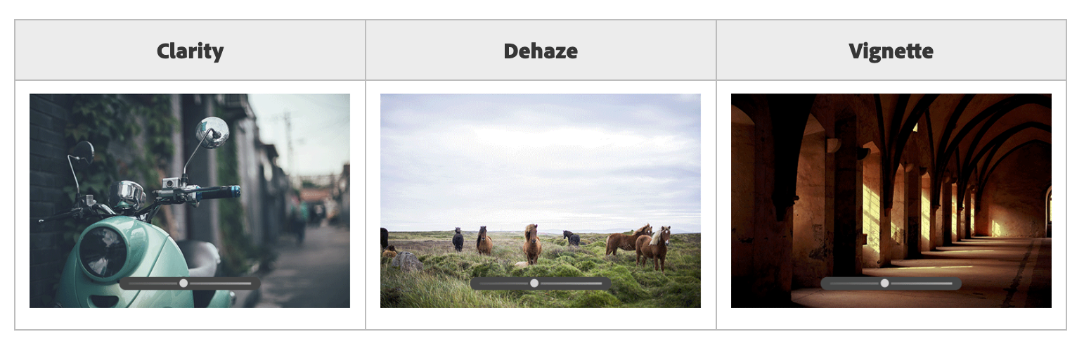
THE EDITING ADVANTAGE
Texture, Clarity, Dehaze, and Vignette
Presence controls are persuasive precisely because they are easy to overuse.
Texture targets fine detail
Clarity changes midtone edge contrast
Dehaze shifts haze and saturation
Vignette controls edge attention
Mastering Adobe Lightroom for Photo Editing | TGS-2022015367 | © Tertiary Infotech Academy Pte Ltd
72

Slide 73
FROM PRINCIPLE TO PRACTICE
Texture, Clarity, Dehaze, and Vignette | What mastery looks like
1
Texture targets fine detail
2
Clarity changes midtone edge contrast
Connect the control or decision to the brief, inspect the evidence, and compare the result.
Connect the control or decision to the brief, inspect the evidence, and compare the result.
3
Dehaze shifts haze and saturation
4
Vignette controls edge attention
Connect the control or decision to the brief, inspect the evidence, and compare the result.
Connect the control or decision to the brief, inspect the evidence, and compare the result.
Mastering Adobe Lightroom for Photo Editing | TGS-2022015367 | © Tertiary Infotech Academy Pte Ltd
73

Slide 74
PRACTICE LENS | CONCEPTUAL REHEARSAL
Texture, Clarity, Dehaze, and Vignette | Decision loop
1
2
3
4
5
Observe
State intent
Adjust
Compare
Verify
Mastering Adobe Lightroom for Photo Editing | TGS-2022015367 | © Tertiary Infotech Academy Pte Ltd
74

Slide 75

THE EDITING ADVANTAGE
Detail, Optics, and Noise
Technical polish is successful when the viewer notices the photograph, not the processing.
Sharpen real edges
Mask sharpening away from smooth areas
Reduce luminance and colour noise
Correct lens and chromatic aberration
Mastering Adobe Lightroom for Photo Editing | TGS-2022015367 | © Tertiary Infotech Academy Pte Ltd
75

Slide 76
FROM PRINCIPLE TO PRACTICE
Detail, Optics, and Noise | What mastery looks like
1
Sharpen real edges
2
Mask sharpening away from smooth areas
Connect the control or decision to the brief, inspect the evidence, and compare the result.
Connect the control or decision to the brief, inspect the evidence, and compare the result.
3
Reduce luminance and colour noise
4
Correct lens and chromatic aberration
Connect the control or decision to the brief, inspect the evidence, and compare the result.
Connect the control or decision to the brief, inspect the evidence, and compare the result.
Mastering Adobe Lightroom for Photo Editing | TGS-2022015367 | © Tertiary Infotech Academy Pte Ltd
76

Slide 77
CASE LENS
Detail, Optics, and Noise | Quality lens
SIGNAL
RISK
BETTER MOVE
Watch for plastic surfaces.
An unexamined edit can create artefacts, inconsistency, rights risk, or a delivery failure.
Inspect at 100%, balance detail against noise, and judge the final output size.
Mastering Adobe Lightroom for Photo Editing | TGS-2022015367 | © Tertiary Infotech Academy Pte Ltd
77

Slide 78
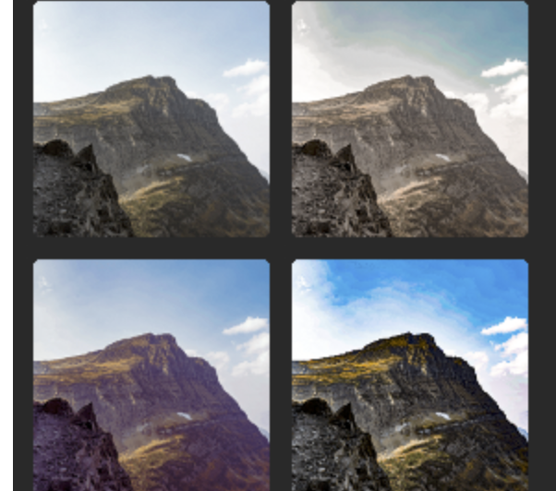
THE EDITING ADVANTAGE
Presets and Batch Consistency
Consistency comes from repeatable intent—not identical slider values.
Profiles set rendering foundations
Presets encode a starting recipe
Copy/paste scales repeated decisions
Synced edits still need image-by-image review
Mastering Adobe Lightroom for Photo Editing | TGS-2022015367 | © Tertiary Infotech Academy Pte Ltd
78

Slide 79
FROM PRINCIPLE TO PRACTICE
Presets and Batch Consistency | What mastery looks like
1
Profiles set rendering foundations
2
Presets encode a starting recipe
Connect the control or decision to the brief, inspect the evidence, and compare the result.
Connect the control or decision to the brief, inspect the evidence, and compare the result.
3
Copy/paste scales repeated decisions
4
Synced edits still need image-by-image review
Connect the control or decision to the brief, inspect the evidence, and compare the result.
Connect the control or decision to the brief, inspect the evidence, and compare the result.
Mastering Adobe Lightroom for Photo Editing | TGS-2022015367 | © Tertiary Infotech Academy Pte Ltd
79

Slide 80
PRACTICE LENS | CONCEPTUAL REHEARSAL
Presets and Batch Consistency | Decision loop
1
2
3
4
5
Observe
State intent
Adjust
Compare
Verify
Mastering Adobe Lightroom for Photo Editing | TGS-2022015367 | © Tertiary Infotech Academy Pte Ltd
80

Slide 81
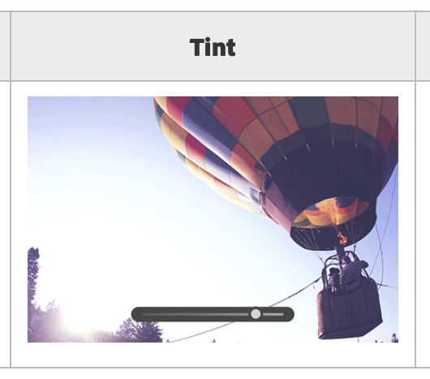
THE EDITING ADVANTAGE
Global Edits Before Local Edits
A stable edit order prevents local fixes from compensating for global problems.
Profile and white balance
Tone and colour
Crop and geometry
Masks, retouch, and finishing
Mastering Adobe Lightroom for Photo Editing | TGS-2022015367 | © Tertiary Infotech Academy Pte Ltd
81

Slide 82
FROM PRINCIPLE TO PRACTICE
Global Edits Before Local Edits | What mastery looks like
1
Profile and white balance
2
Tone and colour
Connect the control or decision to the brief, inspect the evidence, and compare the result.
Connect the control or decision to the brief, inspect the evidence, and compare the result.
3
Crop and geometry
4
Masks, retouch, and finishing
Connect the control or decision to the brief, inspect the evidence, and compare the result.
Connect the control or decision to the brief, inspect the evidence, and compare the result.
Mastering Adobe Lightroom for Photo Editing | TGS-2022015367 | © Tertiary Infotech Academy Pte Ltd
82

Slide 83
CASE LENS
Global Edits Before Local Edits | Quality lens
SIGNAL
RISK
BETTER MOVE
Watch for masking too early.
An unexamined edit can create artefacts, inconsistency, rights risk, or a delivery failure.
Work from broad relationships to small exceptions, then re-check the whole frame.
Mastering Adobe Lightroom for Photo Editing | TGS-2022015367 | © Tertiary Infotech Academy Pte Ltd
83

Slide 84
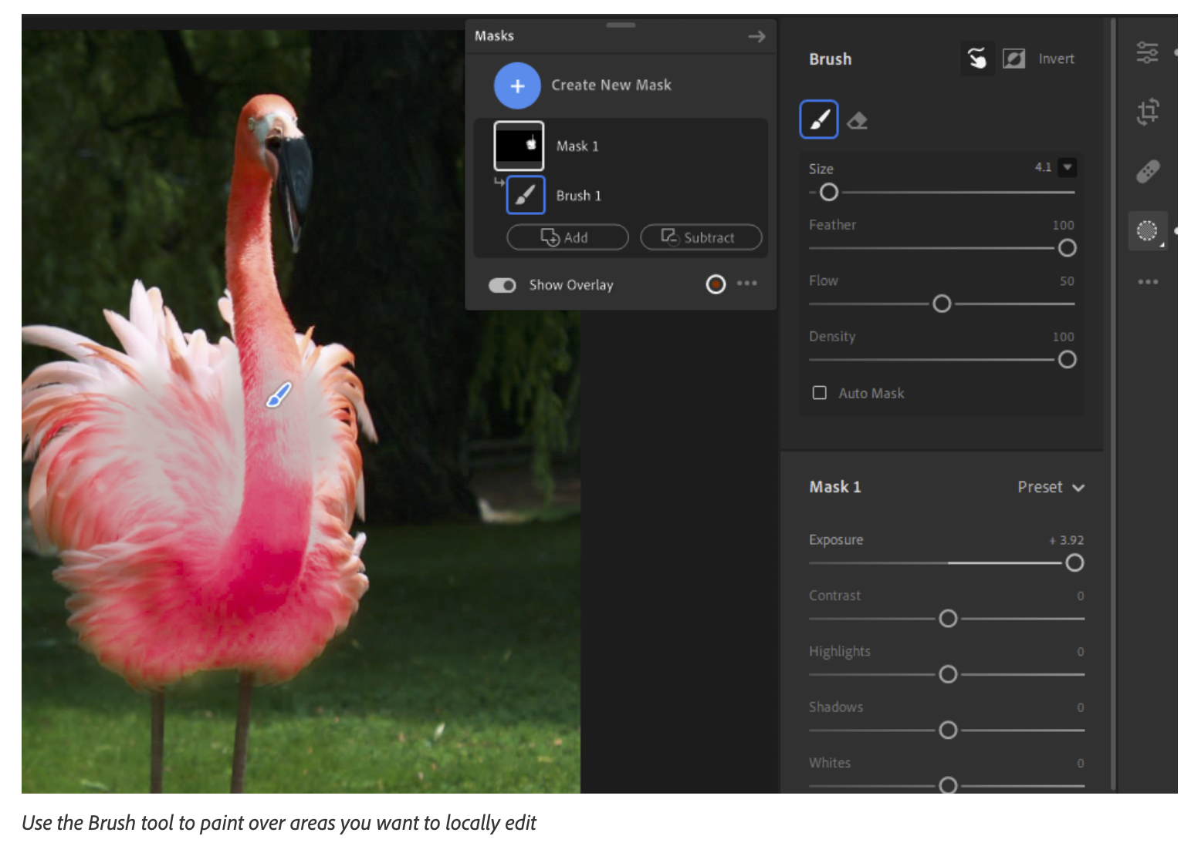
THE EDITING ADVANTAGE
Masking Is Controlled Attention
A good mask is invisible; the viewer experiences emphasis, not an edge.
AI subject, sky, people, objects, landscape
Brush, linear, and radial gradients
Colour and luminance ranges
Add, subtract, intersect, invert
Mastering Adobe Lightroom for Photo Editing | TGS-2022015367 | © Tertiary Infotech Academy Pte Ltd
84

Slide 85
FROM PRINCIPLE TO PRACTICE
Masking Is Controlled Attention | What mastery looks like
1
AI subject, sky, people, objects, landscape
2
Brush, linear, and radial gradients
Connect the control or decision to the brief, inspect the evidence, and compare the result.
Connect the control or decision to the brief, inspect the evidence, and compare the result.
3
Colour and luminance ranges
4
Add, subtract, intersect, invert
Connect the control or decision to the brief, inspect the evidence, and compare the result.
Connect the control or decision to the brief, inspect the evidence, and compare the result.
Mastering Adobe Lightroom for Photo Editing | TGS-2022015367 | © Tertiary Infotech Academy Pte Ltd
85

Slide 86
PRACTICE LENS | CONCEPTUAL REHEARSAL
Masking Is Controlled Attention | Decision loop
1
2
3
4
5
Observe
State intent
Adjust
Compare
Verify
Mastering Adobe Lightroom for Photo Editing | TGS-2022015367 | © Tertiary Infotech Academy Pte Ltd
86

Slide 87
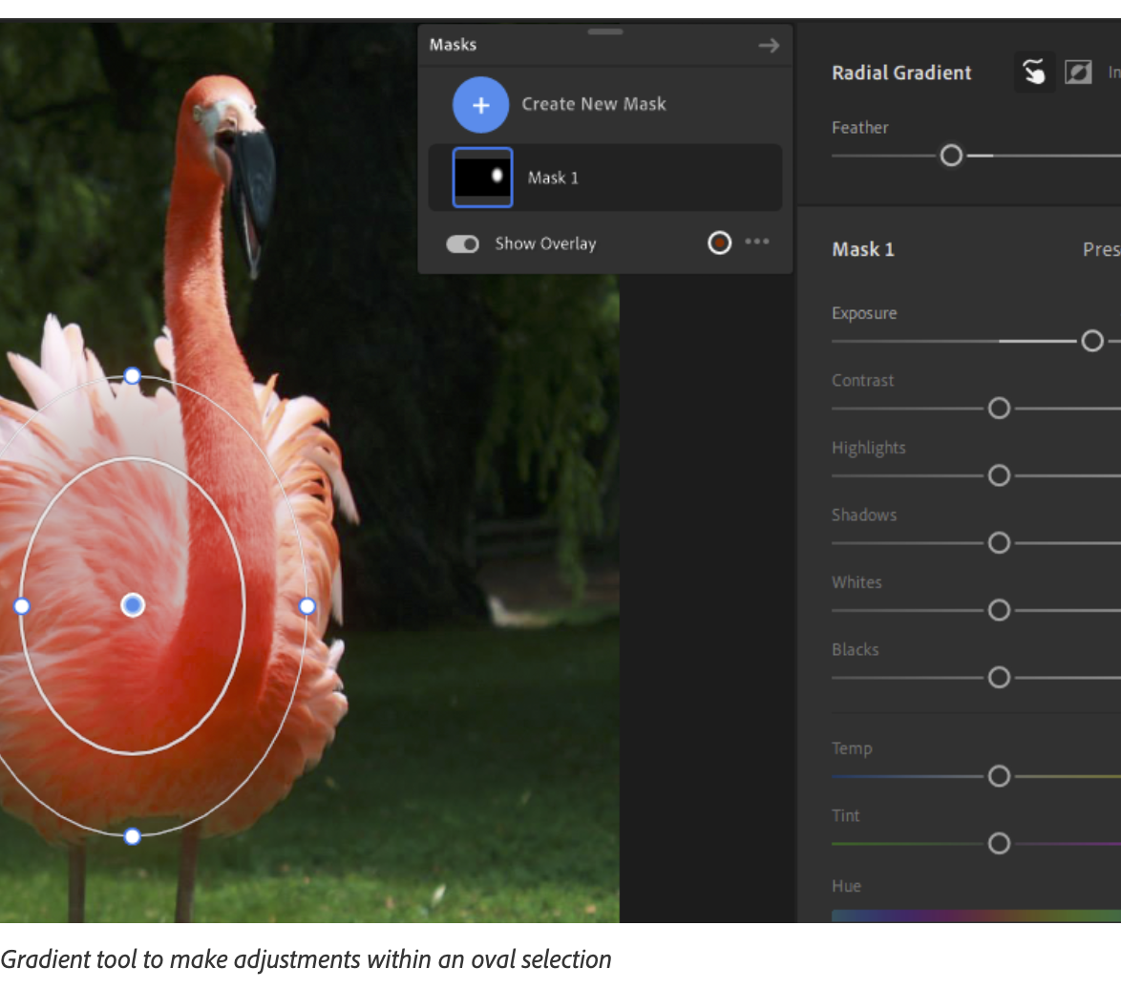
THE EDITING ADVANTAGE
Natural Mask Edges
Selection quality is measured at the transition, not the centre.
Feather softens transitions
Edge expands or contracts selection
Add and subtract repair misses
Intersect limits adjustment precisely
Mastering Adobe Lightroom for Photo Editing | TGS-2022015367 | © Tertiary Infotech Academy Pte Ltd
87

Slide 88
FROM PRINCIPLE TO PRACTICE
Natural Mask Edges | What mastery looks like
1
Feather softens transitions
2
Edge expands or contracts selection
Connect the control or decision to the brief, inspect the evidence, and compare the result.
Connect the control or decision to the brief, inspect the evidence, and compare the result.
3
Add and subtract repair misses
4
Intersect limits adjustment precisely
Connect the control or decision to the brief, inspect the evidence, and compare the result.
Connect the control or decision to the brief, inspect the evidence, and compare the result.
Mastering Adobe Lightroom for Photo Editing | TGS-2022015367 | © Tertiary Infotech Academy Pte Ltd
88

Slide 89
CASE LENS
Natural Mask Edges | Quality lens
SIGNAL
RISK
BETTER MOVE
Watch for halos around hair or horizons.
An unexamined edit can create artefacts, inconsistency, rights risk, or a delivery failure.
Push the adjustment temporarily, refine the boundary, then return to a natural strength.
Mastering Adobe Lightroom for Photo Editing | TGS-2022015367 | © Tertiary Infotech Academy Pte Ltd
89

Slide 90
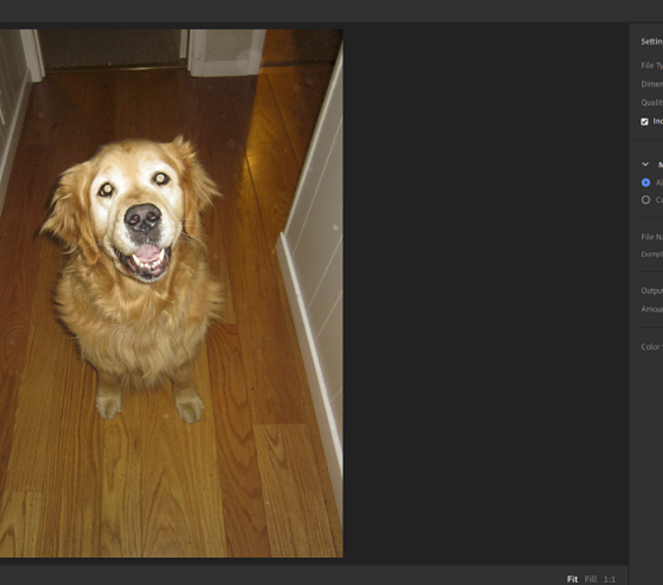
THE EDITING ADVANTAGE
Retouching and Generative Remove
Use the least powerful tool that solves the distraction truthfully and cleanly.
Heal samples texture
Clone copies pixels
Remove handles small distractions
Generative Remove fills larger gaps
Mastering Adobe Lightroom for Photo Editing | TGS-2022015367 | © Tertiary Infotech Academy Pte Ltd
90

Slide 91
FROM PRINCIPLE TO PRACTICE
Retouching and Generative Remove | What mastery looks like
1
Heal samples texture
2
Clone copies pixels
Connect the control or decision to the brief, inspect the evidence, and compare the result.
Connect the control or decision to the brief, inspect the evidence, and compare the result.
3
Remove handles small distractions
4
Generative Remove fills larger gaps
Connect the control or decision to the brief, inspect the evidence, and compare the result.
Connect the control or decision to the brief, inspect the evidence, and compare the result.
Mastering Adobe Lightroom for Photo Editing | TGS-2022015367 | © Tertiary Infotech Academy Pte Ltd
91

Slide 92
PRACTICE LENS | CONCEPTUAL REHEARSAL
Retouching and Generative Remove | Decision loop
1
2
3
4
5
Observe
State intent
Adjust
Compare
Verify
Mastering Adobe Lightroom for Photo Editing | TGS-2022015367 | © Tertiary Infotech Academy Pte Ltd
92

Slide 93
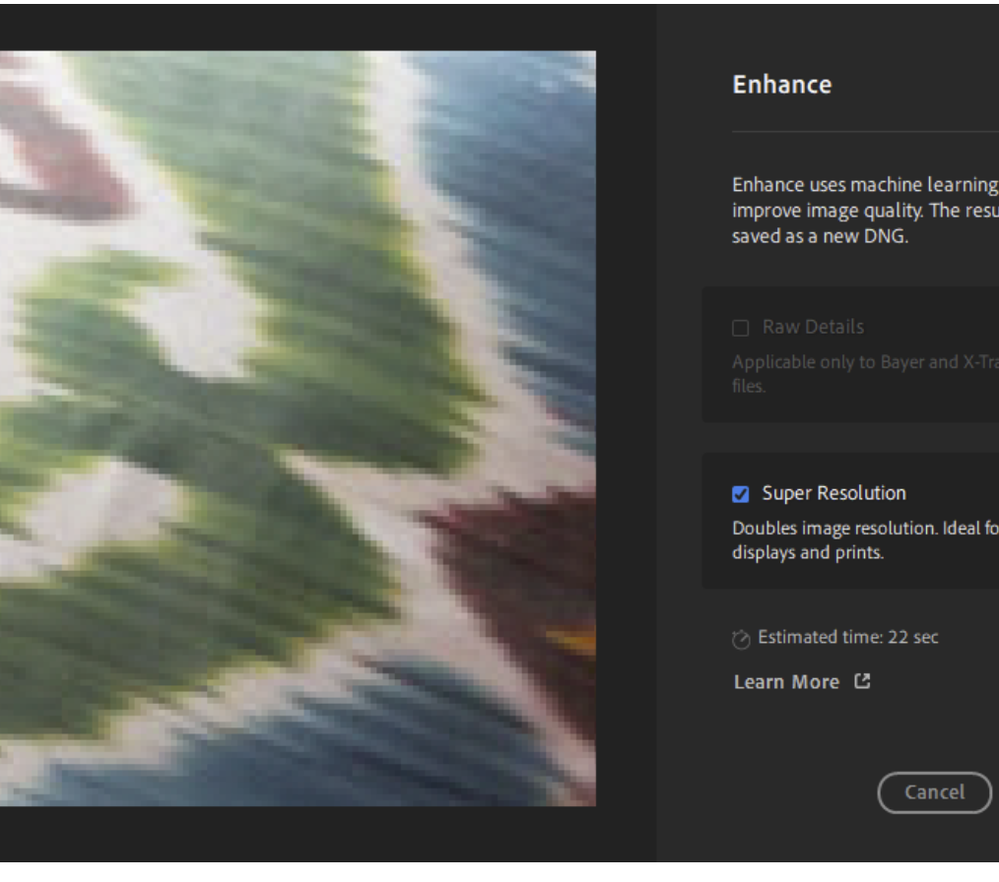
THE EDITING ADVANTAGE
AI Enhancement with Human Quality Control
AI can propose pixels; the editor remains responsible for truth, artefacts, rights, and fitness for use.
Denoise balances noise and detail
AI Sharpen can recover mild blur
Generative Upscale creates larger derivatives
Generative Expand changes boundaries and content
Mastering Adobe Lightroom for Photo Editing | TGS-2022015367 | © Tertiary Infotech Academy Pte Ltd
93

Slide 94
FROM PRINCIPLE TO PRACTICE
AI Enhancement with Human Quality Control | What mastery looks like
1
Denoise balances noise and detail
2
AI Sharpen can recover mild blur
Connect the control or decision to the brief, inspect the evidence, and compare the result.
Connect the control or decision to the brief, inspect the evidence, and compare the result.
3
Generative Upscale creates larger derivatives
4
Generative Expand changes boundaries and content
Connect the control or decision to the brief, inspect the evidence, and compare the result.
Connect the control or decision to the brief, inspect the evidence, and compare the result.
Mastering Adobe Lightroom for Photo Editing | TGS-2022015367 | © Tertiary Infotech Academy Pte Ltd
94

Slide 95
CASE LENS
AI Enhancement with Human Quality Control | Quality lens
SIGNAL
RISK
BETTER MOVE
Watch for trusting a 100% preview.
An unexamined edit can create artefacts, inconsistency, rights risk, or a delivery failure.
Check faces, text, edges, repeated patterns, provenance, and delivery requirements.
Mastering Adobe Lightroom for Photo Editing | TGS-2022015367 | © Tertiary Infotech Academy Pte Ltd
95

Slide 96

THE EDITING ADVANTAGE
HDR, Panorama, and Merge Decisions
Computational range is useful only when it supports a believable scene.
Capture overlap and exposure intentionally
Merge before creative finishing
Inspect seams and ghosting
Keep a natural dynamic range
Mastering Adobe Lightroom for Photo Editing | TGS-2022015367 | © Tertiary Infotech Academy Pte Ltd
96

Slide 97
FROM PRINCIPLE TO PRACTICE
HDR, Panorama, and Merge Decisions | What mastery looks like
1
Capture overlap and exposure intentionally
2
Merge before creative finishing
Connect the control or decision to the brief, inspect the evidence, and compare the result.
Connect the control or decision to the brief, inspect the evidence, and compare the result.
3
Inspect seams and ghosting
4
Keep a natural dynamic range
Connect the control or decision to the brief, inspect the evidence, and compare the result.
Connect the control or decision to the brief, inspect the evidence, and compare the result.
Mastering Adobe Lightroom for Photo Editing | TGS-2022015367 | © Tertiary Infotech Academy Pte Ltd
97

Slide 98
PRACTICE LENS | CONCEPTUAL REHEARSAL
HDR, Panorama, and Merge Decisions | Decision loop
1
2
3
4
5
Observe
State intent
Adjust
Compare
Verify
Mastering Adobe Lightroom for Photo Editing | TGS-2022015367 | © Tertiary Infotech Academy Pte Ltd
98

Slide 99
MASTER EDITOR PRINCIPLE
“Diagnosis should lead the sliders; the sliders should never lead the diagnosis.”
Use this as the topic's decision rule, then prove it through the activity evidence.
ORIGINAL COURSE MAXIM
Mastering Adobe Lightroom for Photo Editing | TGS-2022015367 | © Tertiary Infotech Academy Pte Ltd
99

Slide 100
REAL-WORKPLACE PRACTICE
Activity 03 | Artisan Bakery Product Series: Tone, Colour, and Consistency
K1, K4, K5, A2, A3
A neighbourhood bakery needs a cohesive image set for its online menu. The photographs were captured under mixed lighting and vary in brightness. The food must look warm and inviting but still believable, with consistent whites and product colour across the series.
STAKEHOLDER LENS
EVIDENCE
QUALITY GATE
Work with Lead editor, Bakery owner, Food stylist.
Produce before/after hero comparison and reusable global preset.
No important clipping.
Full click-by-click workflow, scenario, questions, evidence templates, and acceptance criteria are in the Learner Guide and activity PDF pack.
Mastering Adobe Lightroom for Photo Editing | TGS-2022015367 | © Tertiary Infotech Academy Pte Ltd
100

Slide 101
REAL-WORKPLACE PRACTICE
Activity 04 | Heritage Hotel Interior: Composition, Geometry, and Local Light
K4, K5, A2, A3
A heritage hotel wants an interior photograph for a booking page. Vertical lines converge, the window is bright, furniture shadows are deep, and the eye is drawn away from the seating area. The final should feel spacious and calm without misrepresenting the room.
STAKEHOLDER LENS
EVIDENCE
QUALITY GATE
Work with Architectural editor, Hotel marketing lead, Interior designer.
Produce corrected interior image and mask boundary inspection screenshots.
Key lines are credible.
Full click-by-click workflow, scenario, questions, evidence templates, and acceptance criteria are in the Learner Guide and activity PDF pack.
Mastering Adobe Lightroom for Photo Editing | TGS-2022015367 | © Tertiary Infotech Academy Pte Ltd
101

Slide 102
REAL-WORKPLACE PRACTICE
Activity 05 | Community Portrait Campaign: Natural Masking and Retouching
K1, K4, K5, A2, A3
A community campaign needs a warm portrait that feels authentic. The subject is underexposed, the background competes for attention, and small distractions are visible. The client forbids body reshaping and wants skin texture and identity preserved.
STAKEHOLDER LENS
EVIDENCE
QUALITY GATE
Work with Portrait editor, Campaign producer, Subject advocate.
Produce natural portrait edit and mask-refinement evidence.
Identity and skin texture are preserved.
Full click-by-click workflow, scenario, questions, evidence templates, and acceptance criteria are in the Learner Guide and activity PDF pack.
Mastering Adobe Lightroom for Photo Editing | TGS-2022015367 | © Tertiary Infotech Academy Pte Ltd
102

Slide 103
REAL-WORKPLACE PRACTICE
Activity 06 | Tourism Image Rescue: Detail, Removal, and AI Enhancement
K1, K2, K4, K5, A2, A3
A tourism team has a hazy, noisy image that needs a larger display version. There are distracting people and a sensor spot. The image is useful but borderline, so the editor must compare conventional and AI-assisted options, identify artefacts, and recommend whether it is fit for use.
STAKEHOLDER LENS
EVIDENCE
QUALITY GATE
Work with Imaging specialist, Tourism art director, Authenticity reviewer.
Produce conventional and ai-assisted comparison and artefact inspection sheet.
All AI outputs are separate from the original.
Full click-by-click workflow, scenario, questions, evidence templates, and acceptance criteria are in the Learner Guide and activity PDF pack.
Mastering Adobe Lightroom for Photo Editing | TGS-2022015367 | © Tertiary Infotech Academy Pte Ltd
103

Slide 104
EVIDENCE CHECK
Topic 2 | Evidence of competence
PROOF OF EDITING COMPETENCE
The brief, edit decisions, before/after evidence, quality checks, stakeholder response, rights status, and output specification tell one coherent story.
Mastering Adobe Lightroom for Photo Editing | TGS-2022015367 | © Tertiary Infotech Academy Pte Ltd
104

Slide 105
Afternoon Break
10 minutes
Rest your eyes. Return ready to judge detail and colour accurately.
Mastering Adobe Lightroom for Photo Editing | TGS-2022015367 | © Tertiary Infotech Academy Pte Ltd
105

Slide 106

SECTION 03
Process of Digital Image Production
review | collaboration | IP | metadata | export | quality assurance | K6, A4
Observe the image. State the intent. Make a controlled change. Verify the result.
Mastering Adobe Lightroom for Photo Editing | TGS-2022015367 | © Tertiary Infotech Academy Pte Ltd
106

Slide 107
THE EDITING ADVANTAGE
A Production Workflow Is a Decision Trail
Professional editing is repeatable because its decisions can be explained and traced.
Brief and rights
Select and edit
Review and approve
Export, deliver, archive
Mastering Adobe Lightroom for Photo Editing | TGS-2022015367 | © Tertiary Infotech Academy Pte Ltd
107

Slide 108
FROM PRINCIPLE TO PRACTICE
A Production Workflow Is a Decision Trail | What mastery looks like
1
Brief and rights
2
Select and edit
Connect the control or decision to the brief, inspect the evidence, and compare the result.
Connect the control or decision to the brief, inspect the evidence, and compare the result.
3
Review and approve
4
Export, deliver, archive
Connect the control or decision to the brief, inspect the evidence, and compare the result.
Connect the control or decision to the brief, inspect the evidence, and compare the result.
Mastering Adobe Lightroom for Photo Editing | TGS-2022015367 | © Tertiary Infotech Academy Pte Ltd
108

Slide 109
CASE LENS
A Production Workflow Is a Decision Trail | Quality lens
SIGNAL
RISK
BETTER MOVE
Watch for final-file mystery.
An unexamined edit can create artefacts, inconsistency, rights risk, or a delivery failure.
Record purpose, version, approver, export specification, and rights status.
Mastering Adobe Lightroom for Photo Editing | TGS-2022015367 | © Tertiary Infotech Academy Pte Ltd
109

Slide 110
THE EDITING ADVANTAGE
Stakeholder Review Without Slider Debate
Feedback improves when people judge outcomes, not unfamiliar controls.
Show options against the brief
Ask about message and audience
Capture one decision owner
Separate preference from requirement
Mastering Adobe Lightroom for Photo Editing | TGS-2022015367 | © Tertiary Infotech Academy Pte Ltd
110

Slide 111
FROM PRINCIPLE TO PRACTICE
Stakeholder Review Without Slider Debate | What mastery looks like
1
Show options against the brief
2
Ask about message and audience
Connect the control or decision to the brief, inspect the evidence, and compare the result.
Connect the control or decision to the brief, inspect the evidence, and compare the result.
3
Capture one decision owner
4
Separate preference from requirement
Connect the control or decision to the brief, inspect the evidence, and compare the result.
Connect the control or decision to the brief, inspect the evidence, and compare the result.
Mastering Adobe Lightroom for Photo Editing | TGS-2022015367 | © Tertiary Infotech Academy Pte Ltd
111

Slide 112
PRACTICE LENS | CONCEPTUAL REHEARSAL
Stakeholder Review Without Slider Debate | Decision loop
1
2
3
4
5
Observe
State intent
Adjust
Compare
Verify
Mastering Adobe Lightroom for Photo Editing | TGS-2022015367 | © Tertiary Infotech Academy Pte Ltd
112

Slide 113
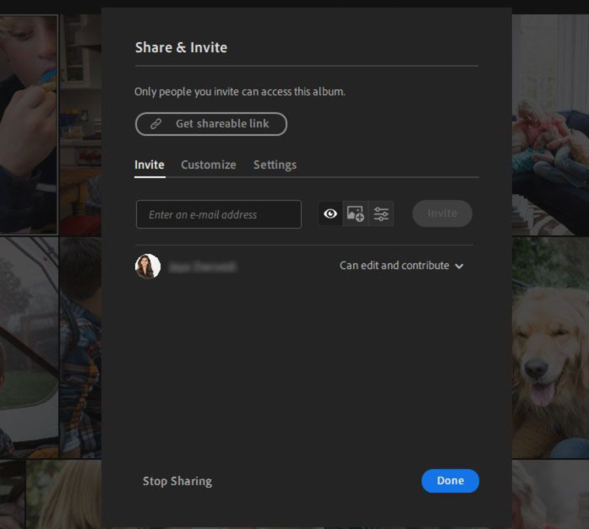
THE EDITING ADVANTAGE
Shared Albums and Collaboration Controls
Sharing is a permissions design problem as much as a presentation choice.
Invite-only or anyone-with-link
Comments and likes
Contributor upload rights
Download, metadata, and location settings
Mastering Adobe Lightroom for Photo Editing | TGS-2022015367 | © Tertiary Infotech Academy Pte Ltd
113

Slide 114
FROM PRINCIPLE TO PRACTICE
Shared Albums and Collaboration Controls | What mastery looks like
1
Invite-only or anyone-with-link
2
Comments and likes
Connect the control or decision to the brief, inspect the evidence, and compare the result.
Connect the control or decision to the brief, inspect the evidence, and compare the result.
3
Contributor upload rights
4
Download, metadata, and location settings
Connect the control or decision to the brief, inspect the evidence, and compare the result.
Connect the control or decision to the brief, inspect the evidence, and compare the result.
Mastering Adobe Lightroom for Photo Editing | TGS-2022015367 | © Tertiary Infotech Academy Pte Ltd
114

Slide 115
CASE LENS
Shared Albums and Collaboration Controls | Quality lens
SIGNAL
RISK
BETTER MOVE
Watch for overshared client material.
An unexamined edit can create artefacts, inconsistency, rights risk, or a delivery failure.
Use least privilege, remove location data when needed, and review access after approval.
Mastering Adobe Lightroom for Photo Editing | TGS-2022015367 | © Tertiary Infotech Academy Pte Ltd
115

Slide 116

THE EDITING ADVANTAGE
Copyright, Licence, and Consent
Possession of a file is not permission to publish it.
Copyright protects original expression
Licences define permitted use
Model/property releases address consent
Trademarks and publicity rights add constraints
Mastering Adobe Lightroom for Photo Editing | TGS-2022015367 | © Tertiary Infotech Academy Pte Ltd
116

Slide 117
FROM PRINCIPLE TO PRACTICE
Copyright, Licence, and Consent | What mastery looks like
1
Copyright protects original expression
2
Licences define permitted use
Connect the control or decision to the brief, inspect the evidence, and compare the result.
Connect the control or decision to the brief, inspect the evidence, and compare the result.
3
Model/property releases address consent
4
Trademarks and publicity rights add constraints
Connect the control or decision to the brief, inspect the evidence, and compare the result.
Connect the control or decision to the brief, inspect the evidence, and compare the result.
Mastering Adobe Lightroom for Photo Editing | TGS-2022015367 | © Tertiary Infotech Academy Pte Ltd
117

Slide 118
PRACTICE LENS | CONCEPTUAL REHEARSAL
Copyright, Licence, and Consent | Decision loop
1
2
3
4
5
Observe
State intent
Adjust
Compare
Verify
Mastering Adobe Lightroom for Photo Editing | TGS-2022015367 | © Tertiary Infotech Academy Pte Ltd
118

Slide 119

THE EDITING ADVANTAGE
Generative AI, Authenticity, and Provenance
Technical possibility does not remove ethical responsibility.
Generated pixels can alter factual meaning
Content Credentials can carry provenance
Document material AI interventions
Editorial uses need stricter judgement
Mastering Adobe Lightroom for Photo Editing | TGS-2022015367 | © Tertiary Infotech Academy Pte Ltd
119

Slide 120
FROM PRINCIPLE TO PRACTICE
Generative AI, Authenticity, and Provenance | What mastery looks like
1
Generated pixels can alter factual meaning
2
Content Credentials can carry provenance
Connect the control or decision to the brief, inspect the evidence, and compare the result.
Connect the control or decision to the brief, inspect the evidence, and compare the result.
3
Document material AI interventions
4
Editorial uses need stricter judgement
Connect the control or decision to the brief, inspect the evidence, and compare the result.
Connect the control or decision to the brief, inspect the evidence, and compare the result.
Mastering Adobe Lightroom for Photo Editing | TGS-2022015367 | © Tertiary Infotech Academy Pte Ltd
120

Slide 121
CASE LENS
Generative AI, Authenticity, and Provenance | Quality lens
SIGNAL
RISK
BETTER MOVE
Watch for synthetic documentary detail.
An unexamined edit can create artefacts, inconsistency, rights risk, or a delivery failure.
Classify the use, preserve originals, disclose material edits, and obtain approval.
Mastering Adobe Lightroom for Photo Editing | TGS-2022015367 | © Tertiary Infotech Academy Pte Ltd
121

Slide 122
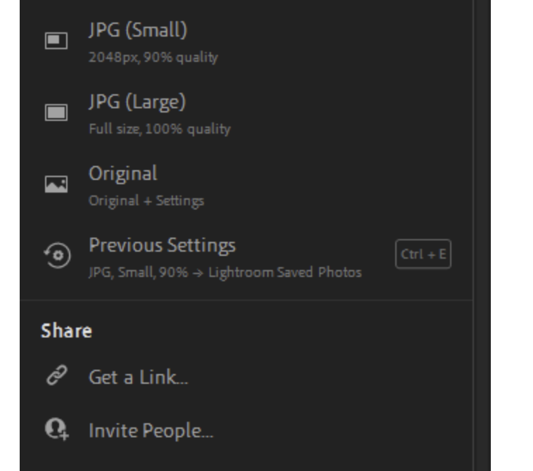
THE EDITING ADVANTAGE
Export Specifications Follow the Destination
Export is translation: preserve the intent while meeting the destination's constraints.
Pixel dimensions and aspect ratio
JPEG quality and file size
sRGB for common digital delivery
Naming, watermark, and metadata
Mastering Adobe Lightroom for Photo Editing | TGS-2022015367 | © Tertiary Infotech Academy Pte Ltd
122

Slide 123
FROM PRINCIPLE TO PRACTICE
Export Specifications Follow the Destination | What mastery looks like
1
Pixel dimensions and aspect ratio
2
JPEG quality and file size
Connect the control or decision to the brief, inspect the evidence, and compare the result.
Connect the control or decision to the brief, inspect the evidence, and compare the result.
3
sRGB for common digital delivery
4
Naming, watermark, and metadata
Connect the control or decision to the brief, inspect the evidence, and compare the result.
Connect the control or decision to the brief, inspect the evidence, and compare the result.
Mastering Adobe Lightroom for Photo Editing | TGS-2022015367 | © Tertiary Infotech Academy Pte Ltd
123

Slide 124
PRACTICE LENS | CONCEPTUAL REHEARSAL
Export Specifications Follow the Destination | Decision loop
1
2
3
4
5
Observe
State intent
Adjust
Compare
Verify
Mastering Adobe Lightroom for Photo Editing | TGS-2022015367 | © Tertiary Infotech Academy Pte Ltd
124

Slide 125
THE EDITING ADVANTAGE
Quality Assurance Before Delivery
The last 2% of inspection protects 100% of client confidence.
Compare to brief and reference
Inspect focus, artefacts, and edges
Verify colour, crop, metadata, and rights
Open the exported file on target devices
Mastering Adobe Lightroom for Photo Editing | TGS-2022015367 | © Tertiary Infotech Academy Pte Ltd
125

Slide 126
FROM PRINCIPLE TO PRACTICE
Quality Assurance Before Delivery | What mastery looks like
1
Compare to brief and reference
2
Inspect focus, artefacts, and edges
Connect the control or decision to the brief, inspect the evidence, and compare the result.
Connect the control or decision to the brief, inspect the evidence, and compare the result.
3
Verify colour, crop, metadata, and rights
4
Open the exported file on target devices
Connect the control or decision to the brief, inspect the evidence, and compare the result.
Connect the control or decision to the brief, inspect the evidence, and compare the result.
Mastering Adobe Lightroom for Photo Editing | TGS-2022015367 | © Tertiary Infotech Academy Pte Ltd
126

Slide 127
CASE LENS
Quality Assurance Before Delivery | Quality lens
SIGNAL
RISK
BETTER MOVE
Watch for shipping from memory.
An unexamined edit can create artefacts, inconsistency, rights risk, or a delivery failure.
Use a checklist and a second reviewer for high-risk or high-volume work.
Mastering Adobe Lightroom for Photo Editing | TGS-2022015367 | © Tertiary Infotech Academy Pte Ltd
127

Slide 128
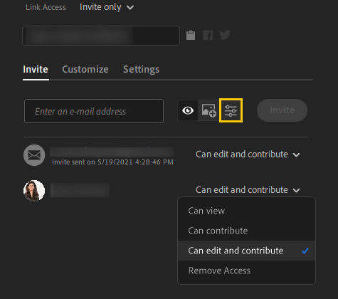
THE EDITING ADVANTAGE
Archive for Reuse and Audit
A reusable archive preserves creative value, rights evidence, and production learning.
Keep originals and approved derivatives
Retain edit history where appropriate
Use clear version and project naming
Apply retention and access rules
Mastering Adobe Lightroom for Photo Editing | TGS-2022015367 | © Tertiary Infotech Academy Pte Ltd
128

Slide 129
FROM PRINCIPLE TO PRACTICE
Archive for Reuse and Audit | What mastery looks like
1
Keep originals and approved derivatives
2
Retain edit history where appropriate
Connect the control or decision to the brief, inspect the evidence, and compare the result.
Connect the control or decision to the brief, inspect the evidence, and compare the result.
3
Use clear version and project naming
4
Apply retention and access rules
Connect the control or decision to the brief, inspect the evidence, and compare the result.
Connect the control or decision to the brief, inspect the evidence, and compare the result.
Mastering Adobe Lightroom for Photo Editing | TGS-2022015367 | © Tertiary Infotech Academy Pte Ltd
129

Slide 130
PRACTICE LENS | CONCEPTUAL REHEARSAL
Archive for Reuse and Audit | Decision loop
1
2
3
4
5
Observe
State intent
Adjust
Compare
Verify
Mastering Adobe Lightroom for Photo Editing | TGS-2022015367 | © Tertiary Infotech Academy Pte Ltd
130

Slide 131
MASTER EDITOR PRINCIPLE
“Professional editing is repeatable because its decisions can be explained and traced.”
Use this as the topic's decision rule, then prove it through the activity evidence.
ORIGINAL COURSE MAXIM
Mastering Adobe Lightroom for Photo Editing | TGS-2022015367 | © Tertiary Infotech Academy Pte Ltd
131

Slide 132
REAL-WORKPLACE PRACTICE
Activity 07 | Capstone: Northstar Retail Campaign Review and Delivery
K1-K6, A1-A4
Northstar Home, a Singapore lifestyle retailer, needs a six-image launch set for web, social media, and an in-store screen. Stakeholders disagree about mood, two source images have uncertain licence records, one portrait contains location metadata, and the marketing lead wants a shareable review album by 3:15 pm. You must manage the brief, editing, evaluation, collaboration, IP checks, and delivery trail.
STAKEHOLDER LENS
EVIDENCE
QUALITY GATE
Work with Lead photo editor, Marketing lead, Brand designer.
Produce creative brief and rights register and six-image edited campaign set.
All K1-K6 and A1-A4 evidence is traceable.
Full click-by-click workflow, scenario, questions, evidence templates, and acceptance criteria are in the Learner Guide and activity PDF pack.
Mastering Adobe Lightroom for Photo Editing | TGS-2022015367 | © Tertiary Infotech Academy Pte Ltd
132

Slide 133
EVIDENCE CHECK
Topic 3 | Evidence of competence
PROOF OF EDITING COMPETENCE
The brief, edit decisions, before/after evidence, quality checks, stakeholder response, rights status, and output specification tell one coherent story.
Mastering Adobe Lightroom for Photo Editing | TGS-2022015367 | © Tertiary Infotech Academy Pte Ltd
133

Slide 134

SECTION 99
Integration
From isolated controls to a production system
Observe the image. State the intent. Make a controlled change. Verify the result.
Mastering Adobe Lightroom for Photo Editing | TGS-2022015367 | © Tertiary Infotech Academy Pte Ltd
134

Slide 135
ONE SYSTEM | MANY IMAGES
The Lightroom Production System
1
2
3
4
5
Brief + rights
Ingest + organise
Global edit
Local refine
Review + deliver
Mastering Adobe Lightroom for Photo Editing | TGS-2022015367 | © Tertiary Infotech Academy Pte Ltd
135

Slide 136
COURSE SUMMARY
What You Achieved
1
EXPLORE
2
IMPROVE
Translate stakeholder intent into testable image decisions.
Build non-destructive global and local editing techniques through deliberate practice.
3
EVALUATE
4
DELIVER
Judge Lightroom capabilities through design, technical, and authenticity evidence.
Review, export, share, and archive with rights and privacy controls.
Mastering Adobe Lightroom for Photo Editing | TGS-2022015367 | © Tertiary Infotech Academy Pte Ltd
136

Slide 137
FINAL EDITOR PRINCIPLE
“A finished image is a visible decision trail.”
When the brief, edit, evidence, rights, approval, and export agree, the work is ready to leave the studio.
ORIGINAL COURSE MAXIM
Mastering Adobe Lightroom for Photo Editing | TGS-2022015367 | © Tertiary Infotech Academy Pte Ltd
137

Slide 138
LEARNER PORTAL
Courseware and Assessment on the LMS
1
Download the learner slides, Learner Guide and activity pack
2
Complete the Oral Questioning and Practical Performance using approved materials
3
Upload the required evidence to the LMS
4
https://lms-tms.tertiaryinfotech.com/
Mastering Adobe Lightroom for Photo Editing | TGS-2022015367 | © Tertiary Infotech Academy Pte Ltd
138

Slide 139
FINAL REMINDER
Assessment
OQ | 30 MIN
PP | 60 MIN
SUBMIT
Six open-ended knowledge questions K1-K6.
Three connected production tasks A1-A4.
Assessment attendance, LMS evidence upload, and summary-record signature.
Mastering Adobe Lightroom for Photo Editing | TGS-2022015367 | © Tertiary Infotech Academy Pte Ltd
139

Slide 140
FINAL ASSESSMENT PROCESS
Assessment Flow
1
2
3
4
5
TRAQOM
Assessment attendance
OQ then PP
Submit on LMS
Sign summary record
Mastering Adobe Lightroom for Photo Editing | TGS-2022015367 | © Tertiary Infotech Academy Pte Ltd
140

Slide 141
TRAQOM · SSG
Digital Attendance | Mandatory
1
AM
2
PM
Morning attendance recorded.
Afternoon attendance recorded.
3
ASSESSMENT
4
COMPLETE
Assessment attendance recorded separately.
Confirm submission with the trainer before leaving.
Mastering Adobe Lightroom for Photo Editing | TGS-2022015367 | © Tertiary Infotech Academy Pte Ltd
141

Slide 142
Thank You
Edit with intention. Check the evidence. Protect the original.
enquiry@tertiaryinfotech.com | +65 6100 0613 | www.tertiarycourses.com.sg
Mastering Adobe Lightroom for Photo Editing | TGS-2022015367 | © Tertiary Infotech Academy Pte Ltd
142

